Slide 1



Strengthened Ocean-desert Process in the North Pacific
over the Past Two Decades
Presenter：Siyu Meng
Frontiers Science Center for Deep Ocean Multispheres and Earth System, and Key Laboratory of Marine Environment and Ecology, Ministry of Education of China
Ocean University of China, Qingdao, China
E-mail：756997290@qq.com
2020-10-28
Topic-VS4

Slide 2
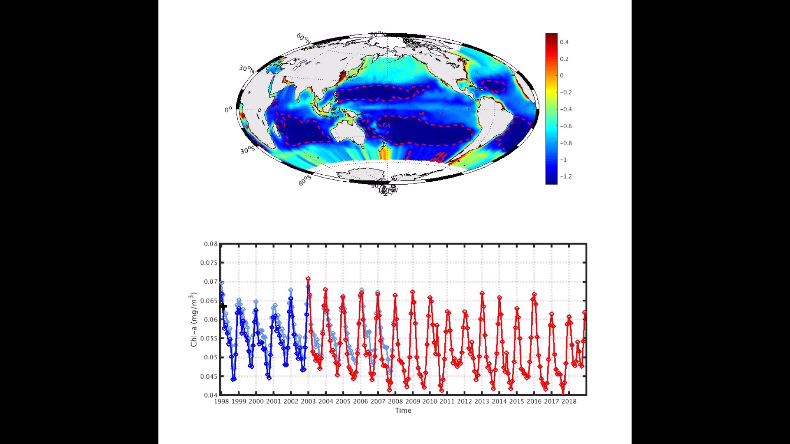
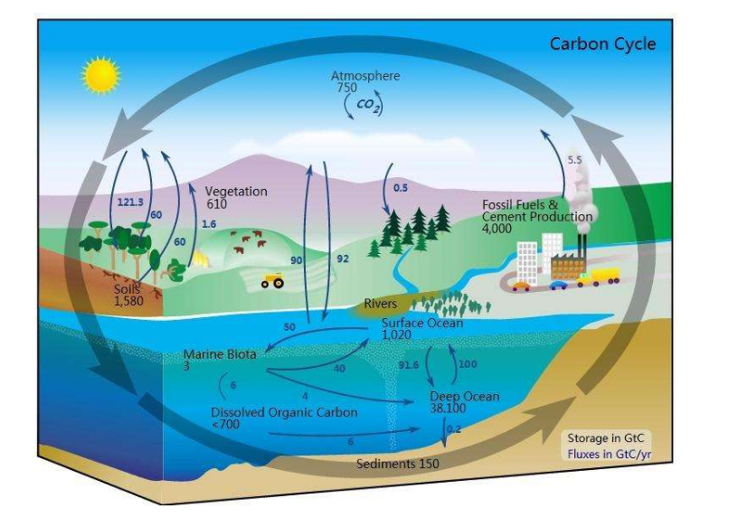
Introduction：ocean desert
North pacific ocean desert （NPOD）
1
Their immense size
(they occupy ~40% of low-latitude ocean area
The carbon exported
from the surface to the deep ocean.
2
marine dessert: Chl ≤ 0.07 mg/m³
3
Long-term variation
Figure 1 Global ocean surface mean Chl-a concentration from 1998 to 2018. The red dashed line represents the 0.07 mg/m³ contours of Chl-a, the boxes delimited by the blue dashed lines is the study area.
1

Slide 3
Introduction ：long-term variation ocean desert
Change in Mean Chl-a
Change In Area
Reference
Journal
Time Range
Total NP NA IS SP SA
Total NP NA IS SP SA
McClain et al., 2004
Deep-Sea Research II
1996-2003
1996
Gregg et al., 2004
Geophysical Research Letters
1998-2003
Behrenfeld et al., 2006
Nature
1998-2003
2000
Polovina et al.,
2008
Geophysical Research Letters
1998-2008
Irwin et al.,
2009
Geophysical Research Letters
1998-2007
2005
Charles et al.,
2009
Deep Sea Research Part II
1998-2010
Boyce et al.,
2010
Progress in Oceanography
2010
1960-2008
Based on a combined, longest dataset of Chl-a
We investigate the deseasoned variations of NPOD during Year 1998 to 2018.
Gregg et al.,
2014
Journal of Geoph-ysical Research
1998-2014
2015
Babula et al.,
2014
Deep-Sea
Research I
1998-2010
2019
2

Slide 4
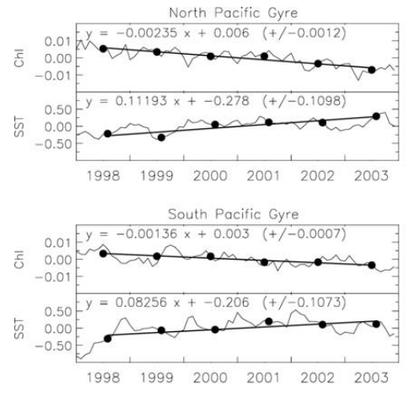
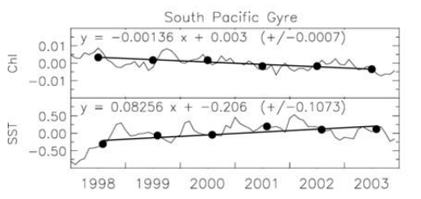
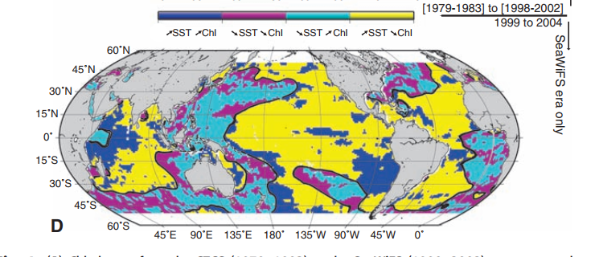
Introduction ：potential factors
1-SST(sea suface temperature)
2-WS(wind speed)
3-SSH(sea surface height)
4-PRE(precipitaiton)
nutrients
Gregg et al (2005)
1998-2004
5-AOD(Aerosol Optical Depth)
6-PAR(photosynthetically active radiation)
Chl-a
temperature
sunlight
Elodie et al (2005)
Figure 2 Map of areas with concomitant parallel or opposite changes of Chl and SST, as indicated between 1999 and 2004.
3

Slide 5


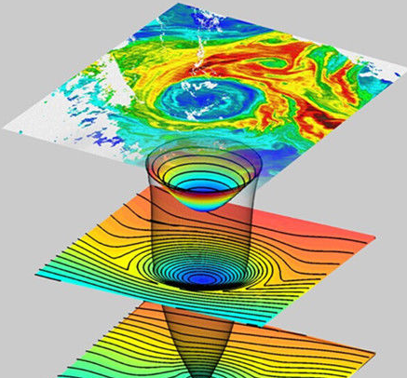
Data
Data source
Chl-a：
Moderate-Resolution Imaging Spectroradiometer
(MODIS)
Sea-viewing Wide Field-of-view Sensor
(SeaWiFS)
spatial resolution :1/12º
temporal resolution: 1 day
January 1, 1998---December 31, 2018 (a total of 21 years)
13-day running mean
100-km running mean
4

Slide 6
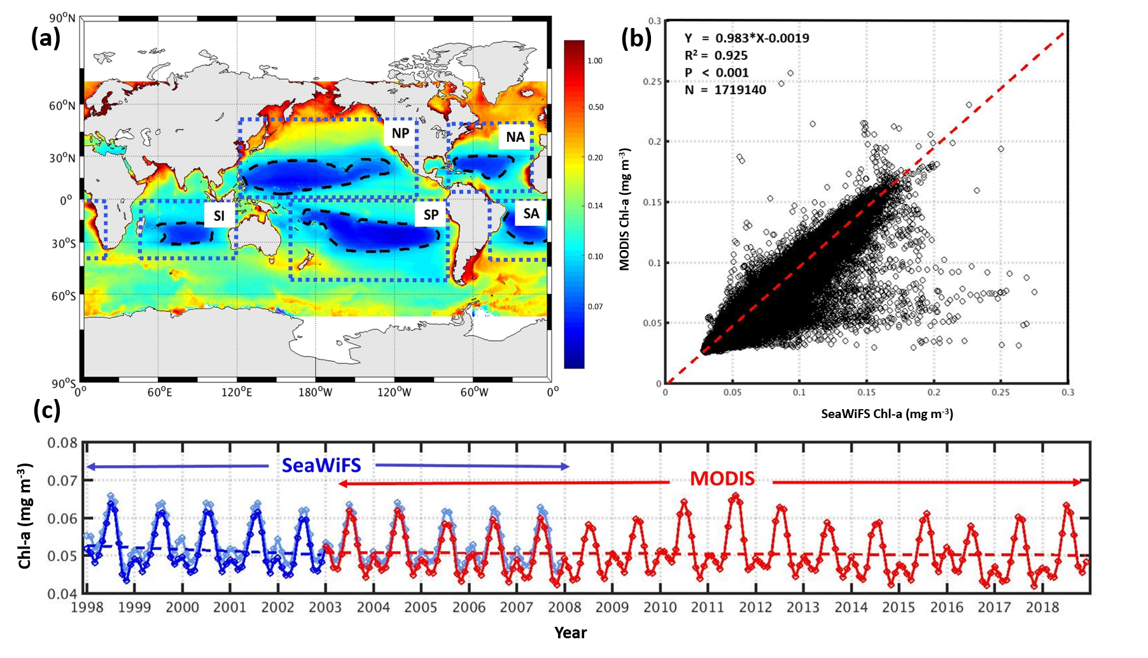
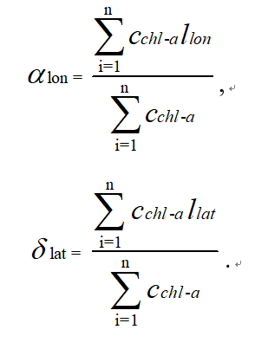
Data and method
ocean desert
variation
intensity
McClain et al (2004)
Polovina et al (2008)
area
position
Hsin et al (2013)
Figure 3 (a) NPOD geographical region (dashed black curve), and the color shadings show global ocean surface mean Chl-a concentration (b) Comparison of monthly surface Chl-a concentration retrieved by SeaWiFS and MODIS-Aqua during 2003–2007 in five ocean deserts (c) Time series of monthy Chl-a concentrations in global ocean deserts area (the black dashed line in a) retrieved by SeaWiFS (light blue curve for raw data; blue curve for merged data) and MODIS-Aqua (red curve).
5

Slide 7
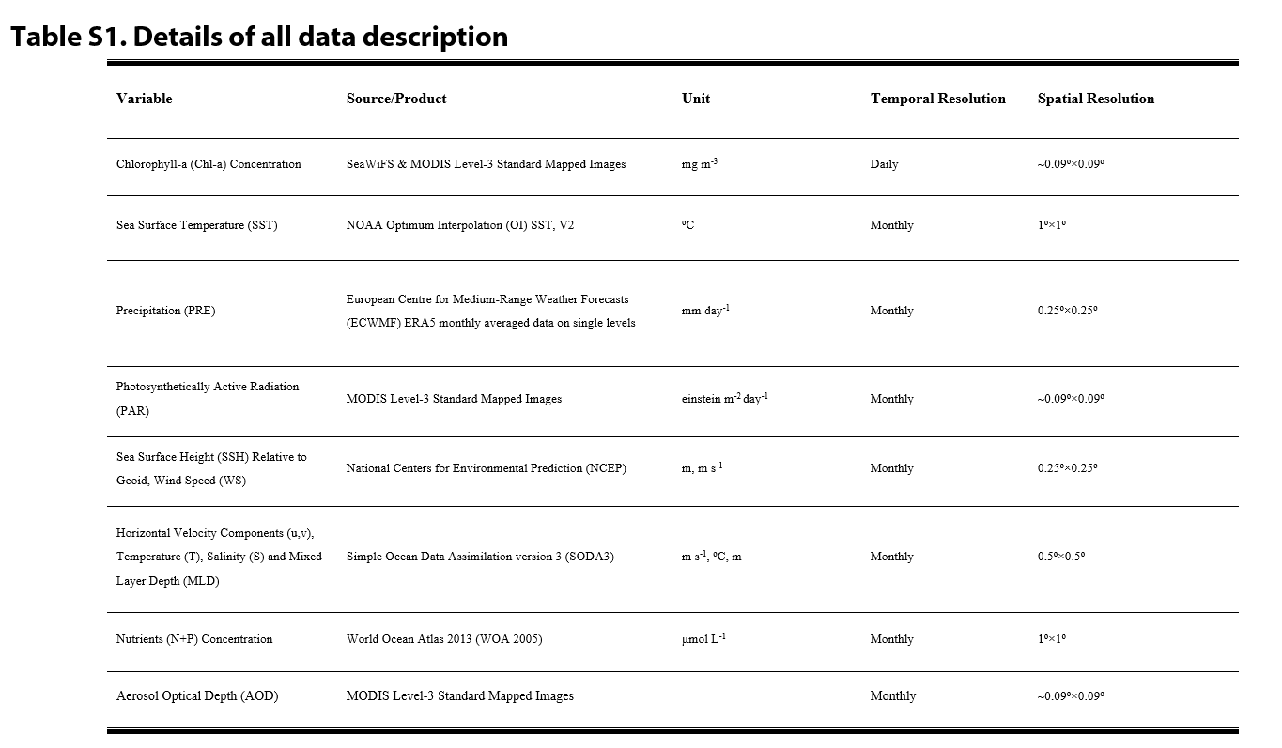
Data and method
Nutrients (N + P)
concentration
Mixed Layer Depth (MLD)
Horizontal velocity components, temperature, salinity data
A 1D K-Profile Parameterization (KPP) model
6

Slide 8
Results and discussion：intensity and area of NPOD
argest ocean desert globally
the most significant decline
North Pacific Ocean Desert（NPOD）
(c)
oligotrophication
-2.1×10⁻⁴ mg m⁻³ yr⁻¹
(-0.43 % yr⁻¹)
expansion
13.5×10⁴ km² yr⁻¹
(around 0.9 % yr⁻¹)
(d)
Figure 4 Trends of intensity and area of the North Pacific Ocean Desert (NPOD).
7

Slide 9
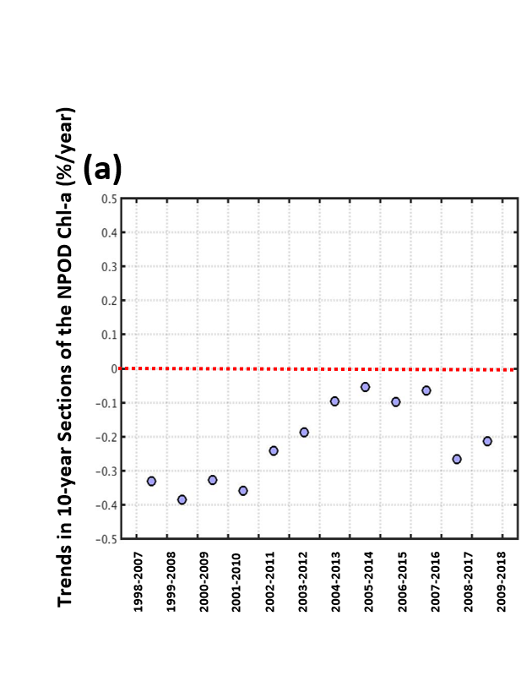
Results and discussion ：intensity and area of NPOD
10-year sections in Chl-a concentration Change
sensitivity test
Figure 6 Climatological mean area (bar chart, left axis) and area change (line chart, right axis) with different thresholds.
Figure 5 Rates of 10-year sections in Chl-a concentration Changes of the NPOD
8

Slide 10
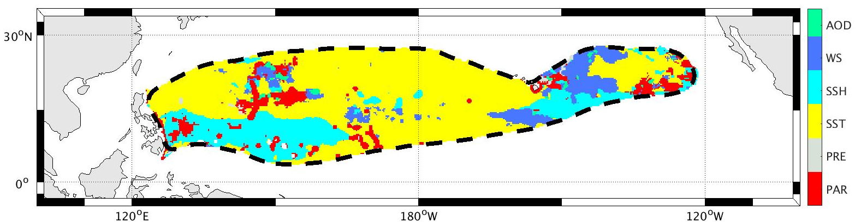
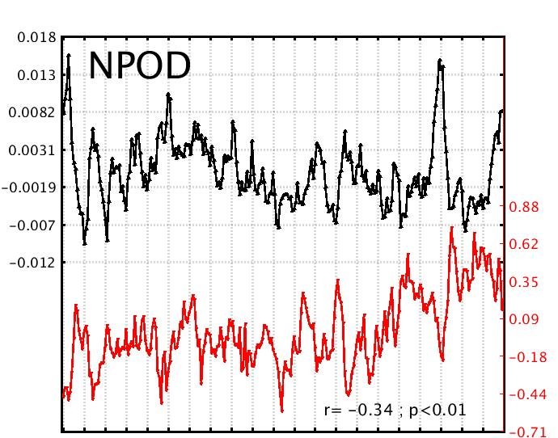
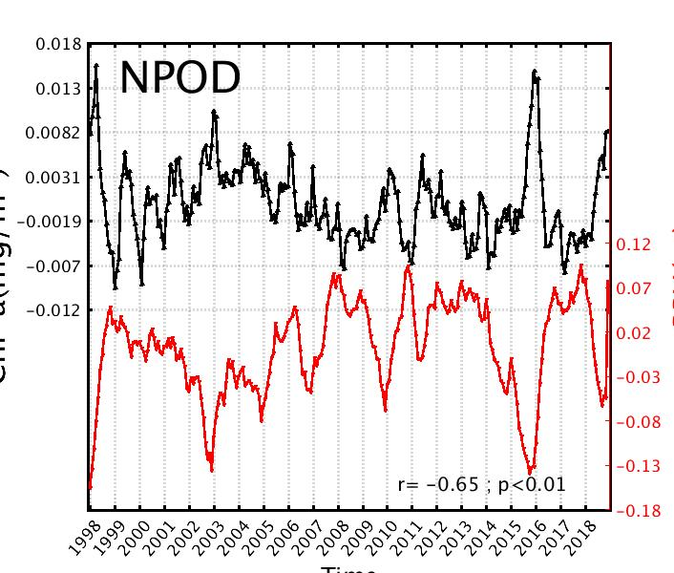
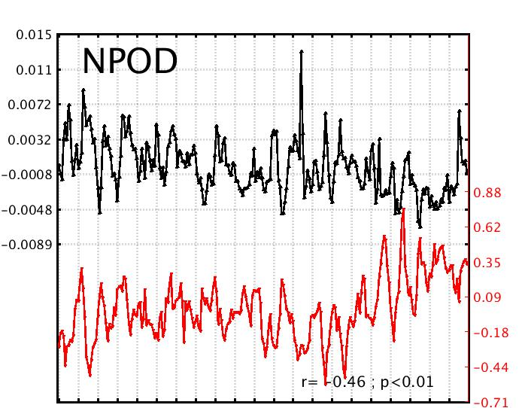
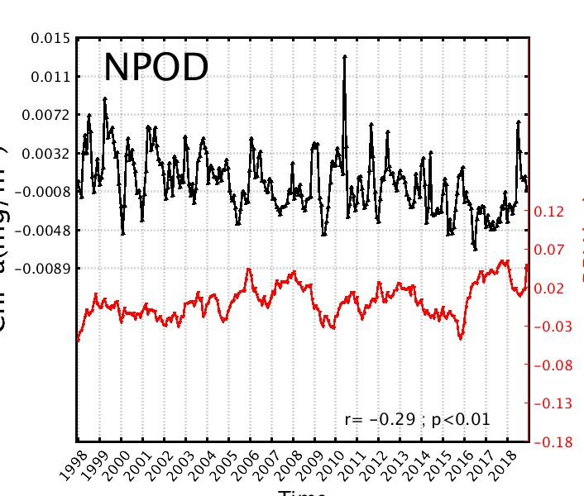
Results and discussion： potential factors
(a)
(b)
(c)
(d)
(e)
SSH
SSH
SST
SST
Chl-a (mg m⁻³)
Chl-a (mg m⁻³)
Chl-a (mg m⁻³)
Chl-a (mg m⁻³)
SST (ºC)
SSH (m)
SST (ºC)
SSH (m)
Year
Year
Year
Year
Figure 7 (a) North Pacific Ocean Desert (NPOD) geographical region (dashed black curve), and the color represents the dominating factor of Chl-a variation. (b-e) Deseasoned time series of Chl-a concentration are correlated with the deseasoned sea surface temperature and sea surface height in NPOD.
9

Slide 11
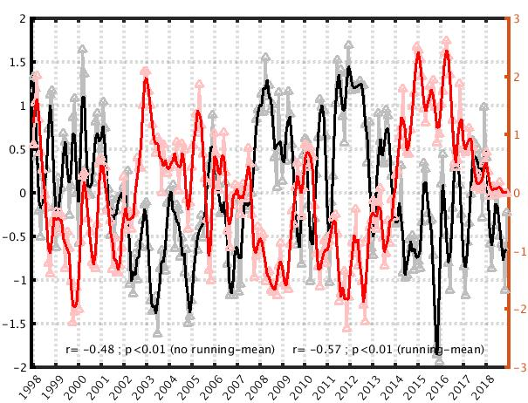
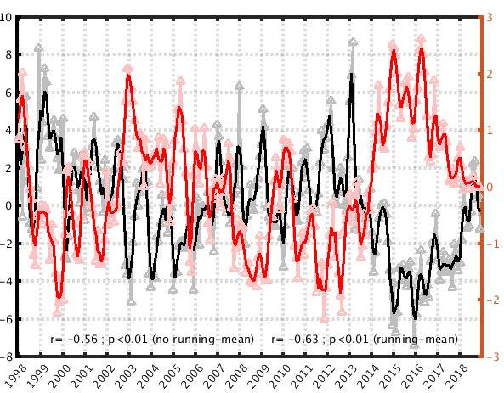
Results and discussion： oscillation of NPOD position
(a)
Correlation Coefficient between Chl-a and PDO
Pacific Decadal Oscillation (PDO)
‘horseshoe’ pattern of SST
Chl-a change at boundaries
northwest-southeast oscillation
(b)
(c)
N
W
PDO
Latitude (^{O})
PDO
PDO
Longitude (^{O})
Year
S
E
Figure 8 (a) correlation coefficient between the PDO Index and deseasoned Chl-a time series. (b, c) Time series of PDO Index and NPOD central position
Year
Year
10

Slide 12
Results and discussion：Linkage of NPOD to ocean physics
vertical stratification
Temperature gradient
Density gradient
Mixture Coefficients (KM)
in KPP model
Mixed layer depth(MLD)
11
Year
Figure 9 Temperature gradient and density gradient in NPOD.
Figure 10 Impact of sea surface temperate (SST) variation on the NPOD oligotrophication

Slide 13
Conclusion
Oligotrophication
Expansion
NW-SE oscillation
SST SSH
PDO precesses
Figure 11 Schematic of the interactive mechanism between the North Pacific Ocean Desert (NPOD) and multiple climate factors.
12

Slide 14
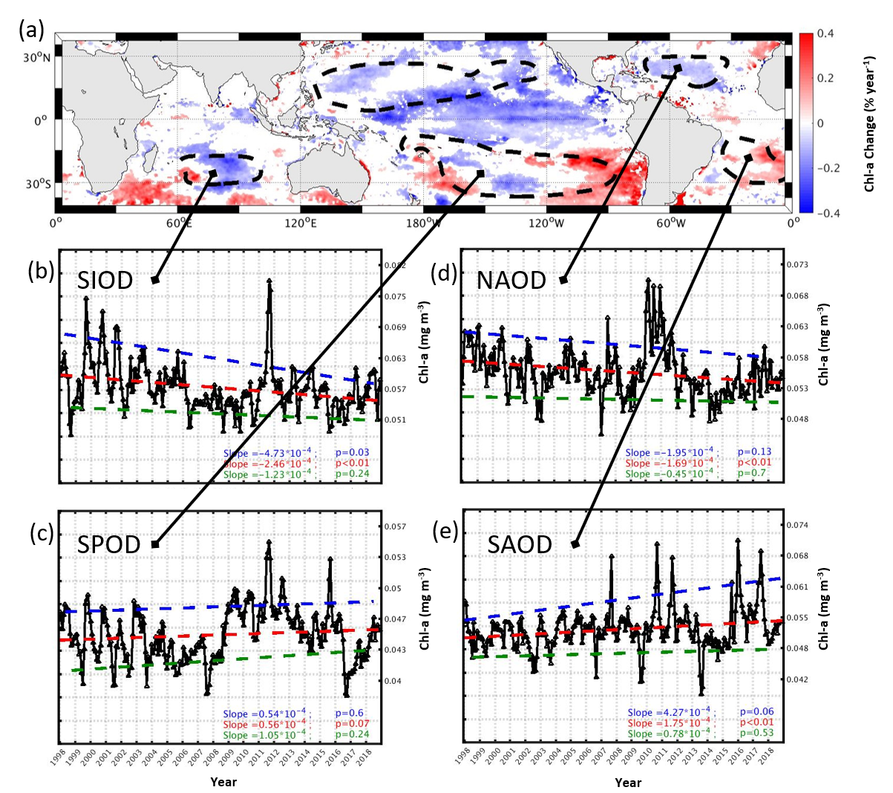
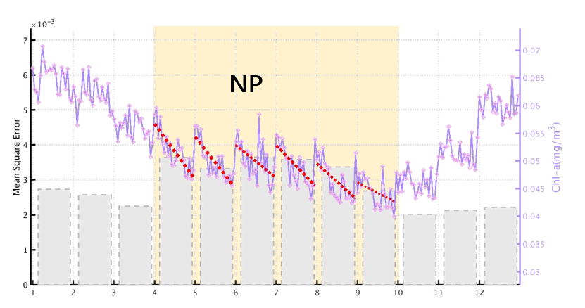
Future Plan
Other four ocean deserts
Seasonality of ocean deserts
NPOD
Figure 12 Oligotrophication posecesses in different month.
Figure 13 Spatial (a) and temporal (b-e) changes of the SIOD, SPOD, NAOD and SAOD intensity
13

Slide 15
Thanks for your attention
2020-10-28
Topic-VS4

