Slide 1
CHAIR AWARD
Established in 2016 by PICES Governing Council
Awarded for sustained contributions to the development of PICES, that have allowed it to meet its purpose as set out in Article III of the PICES Convention:
Article III: Purpose of the Organization:
to promote and coordinate marine scientific research in order to advance scientific knowledge of the area concerned and of its living resources, including but not necessarily limited to research with respect to the ocean environment and its interactions with land and atmosphere, its role in and response to global weather and climate change, its flora, fauna and ecosystems, its uses and resources, and impacts upon it from human activities;
to promote the collection and exchange of information and data related to marine scientific research in the area concerned.
Notes:
1

Slide 2
Past recipients
2016: R. Marasco (USA) and A. Bychkov (PICES Secretariat)
2018: T. Wada (Japan) and J. Stein (USA)
2019: P. Livingston (USA)

Slide 3
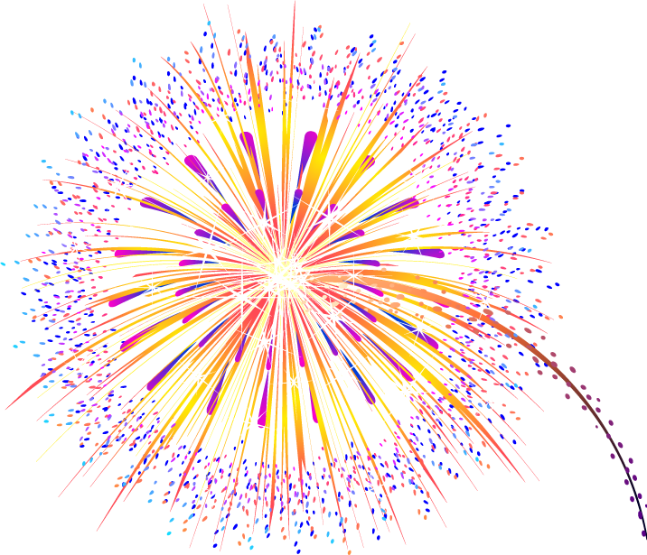
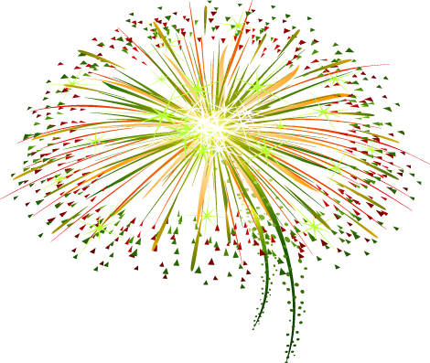
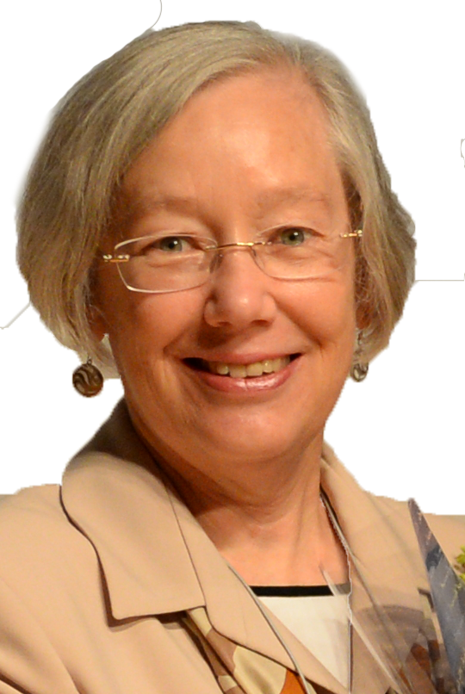
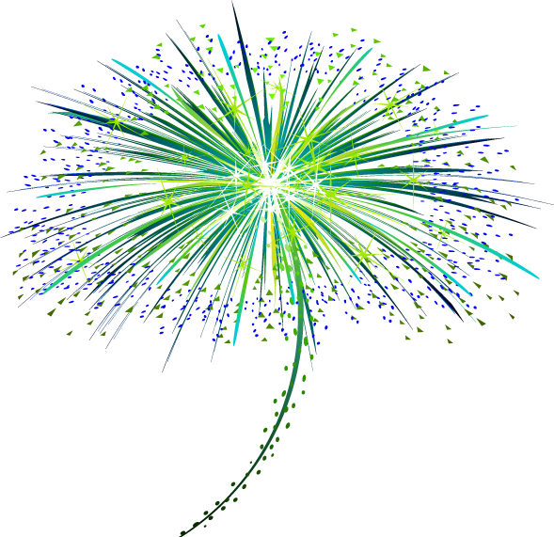
PICES-2021 CHAIR AWARD
Dr. Laura Richards

Slide 4
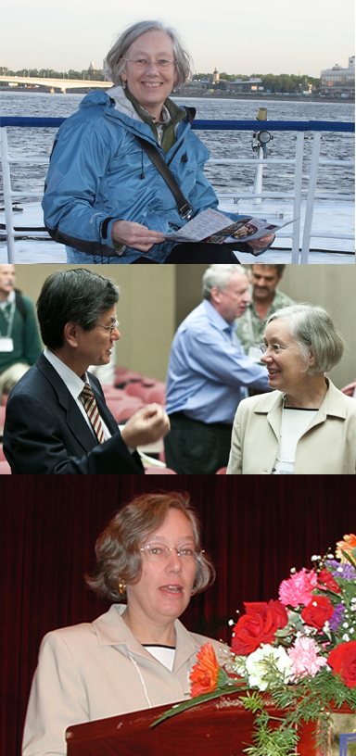
2021 CHAIR AWARD Recipient: dr. Laura richards
SELECTED Roles:
PICES Chair (2012–2016); PICES Vice-Chair 2010–2012
Canadian Delegate to PICES GC 2000–2010
Two-term Chair of the Finance and Administration Committee (2004-2008)
Active member of Fisheries Science Committee; active participant in several Expert Groups including: SG-RSP (Revising Strategic Plan); SG-SI (PICES Strategic Issues); SG-RPFR (PICES Rules of Procedure / Financial Regs.); SG-RAM (Restructuring PICES Annual Meeting)
Nurtured International partnerships (ICES, NPAFC, NOWPAP, ISC, etc.) furthering PICES recognition as a Marine Science Information authority.
Notes:
4

Slide 5
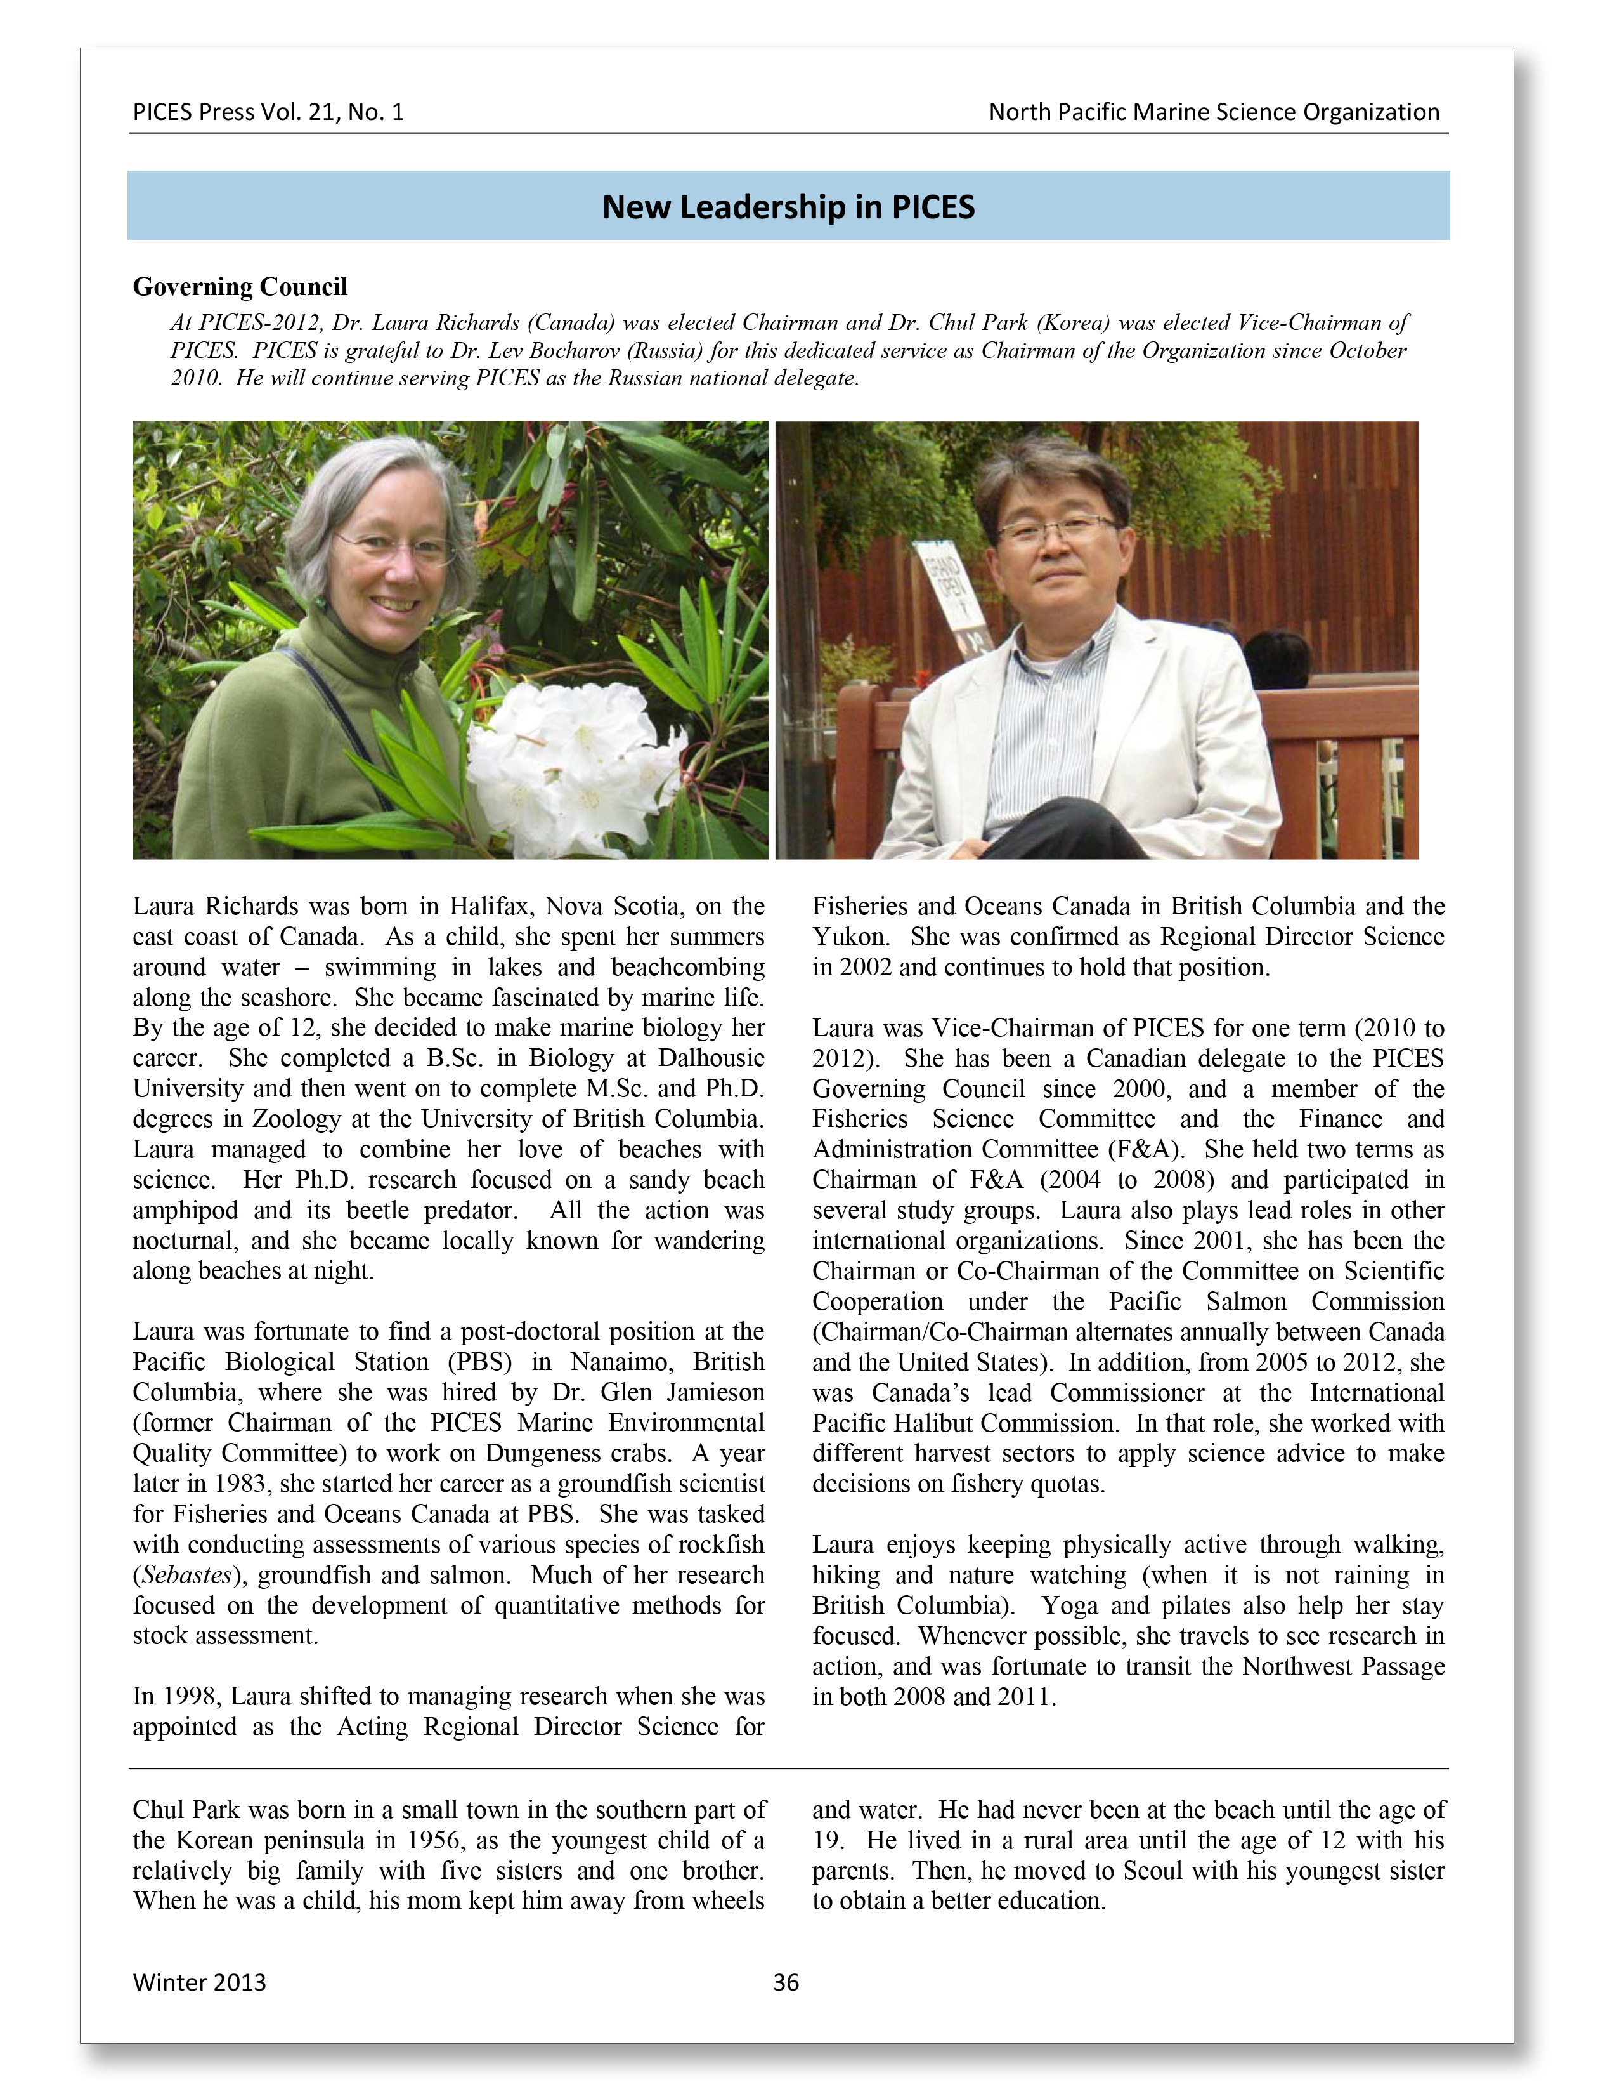
2021 CHAIR AWARD Recipient: dr. Laura richards
SELECTED Accomplishment Highlights:
As F&A Chair, led review and updating of PICES Rules of Operation and PICES Financial Regulations – ensuring structures Governance and Financial Mgmt structures to better fit the needs of a maturing organization;
Collaborated to set the bold ambitious vision for scientific & technical innovation and cultural diversity through the revised PICES Strategic Plan
These two activities have helped guide PICES since 2016
Supported and promoted the establishment of PICES Open Access Policy, to help increase PICES Science Uptake.
Recruited young scientists to PICES and has served as PICES ambassador within Canada
Notes:
5

Slide 6
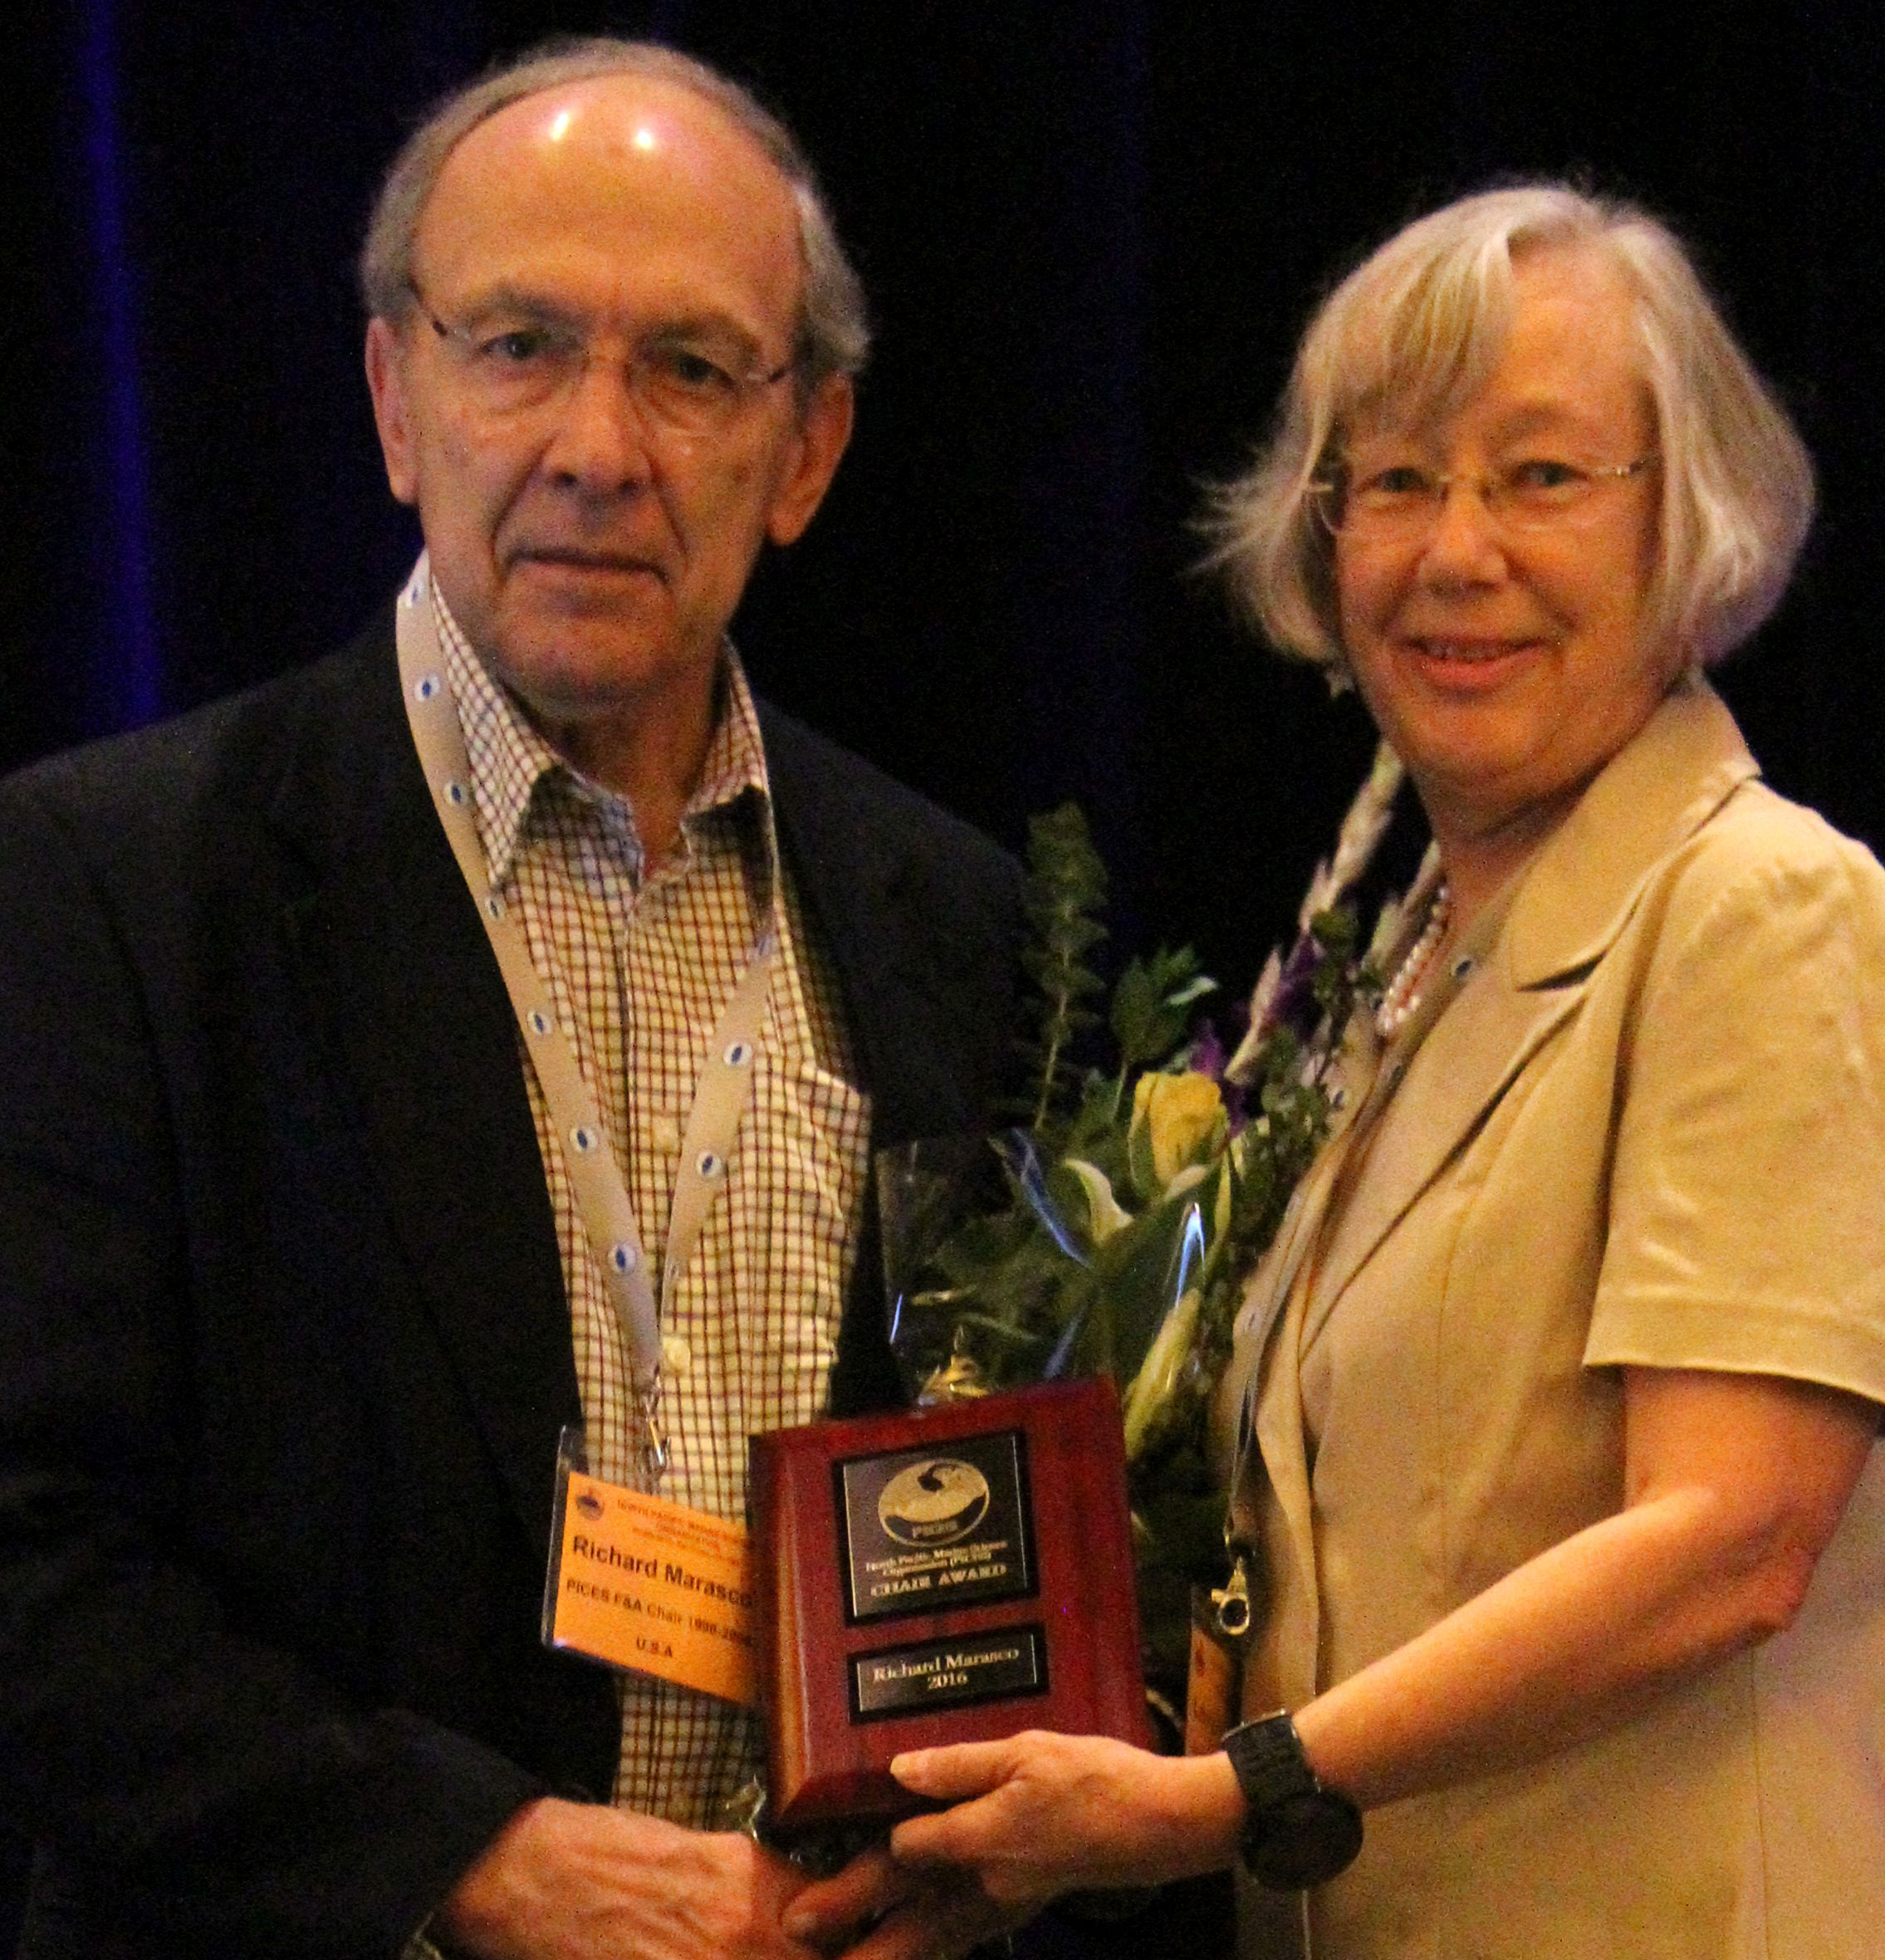
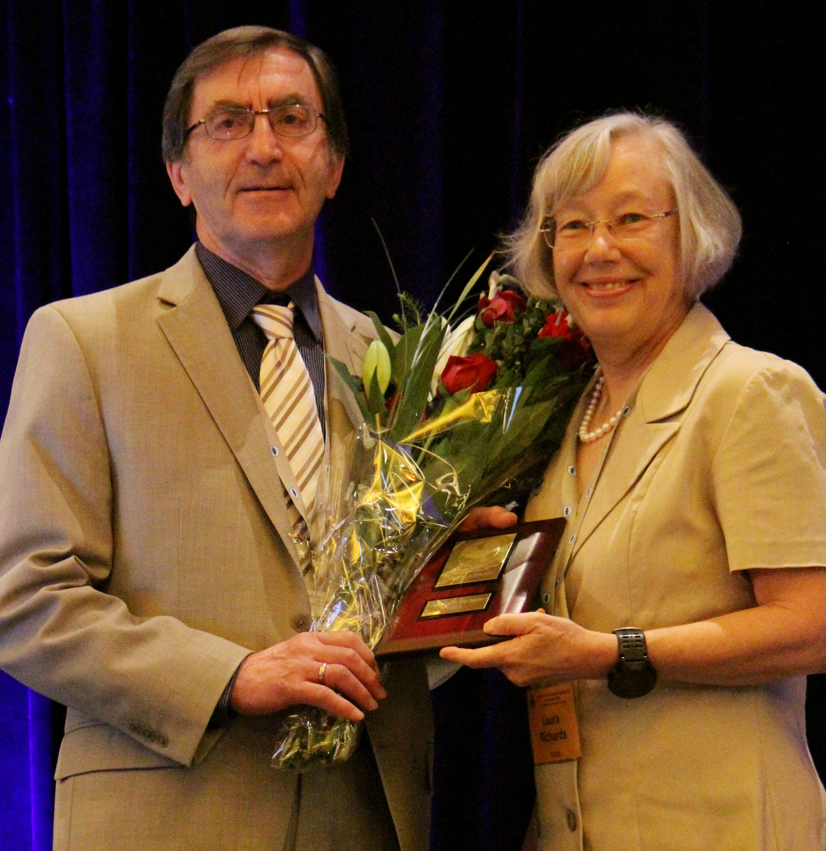
CHAIR AWARD
The first-ever PICES Chair Awards were presented in 2016 by Dr. Laura Richards, to (the late) Dr. Richard Marasco and Dr. Alex Bychkov:
Notes:
6

Slide 7
THANK YOU, Laura,
For your long-term service
to PICES
Dr. Laura Richards

