Slide 1


Predict the future of PICES under UN Ocean Decade
Fangli QIAO
First Institute of Oceanography, MNR, China
26 Oct., 2021 PICES Annual Meeting

Slide 2
1
Requirements and challenges
CONTENTS
2
New era for ocean prediction
3
Applications in climate and TC
4
Summary

Slide 3
7 Outcomes of the UN Decade
Clean Ocean
A Predicted Ocean
Health Ocean
UN Decade of Ocean Science for sustainable development
(2021-2030)
Inspiring
& Engaging Ocean
Safe Ocean
Productive Ocean
Accessible Ocean

Slide 4
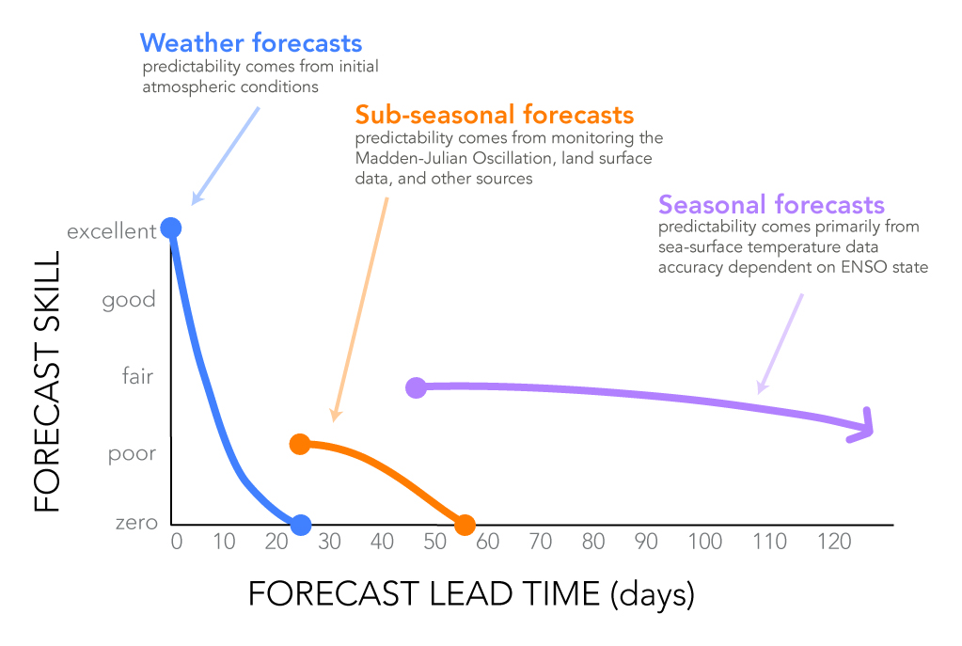
We need long-term prediction: The longer, the better such as climate change
from http://iri.columbia.edu/news/qa-subseasonal-prediction-project/

Slide 5
Heat content of 3 m sea water = total air, so the upper ocean controls the long-term prediction of ocean and climate. However,
Ground challenges I: The simulated MLD is too shallow in summer for half century: Lack of mixing
MLD from observation
MLD from ocean model

Slide 6
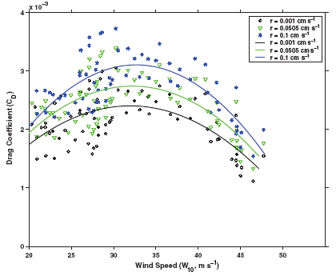
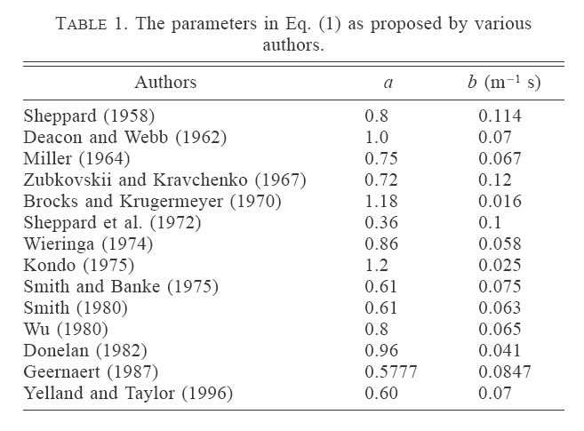
Air-sea interaction is another key. To take momentum flux as an example
(Guan et al, JPO, 2004)
(Jarosz et al, Science, 2007)

Slide 7
What is turbulence?
Richard Feynman (Nobel Prize, 1965) “turbulence is the
most important unsolved problem of classical physics."
Werner Heisenberg (Nobel Prize, 1932) was asked what he would ask God, given the opportunity. His reply was: "When I meet God, I am going to ask him two questions: Why relativity? And why turbulence?
I really believe he will have an answer for the first."

Slide 8
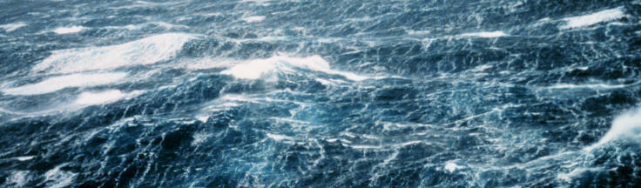
Non-breaking wave-induced vertical mixing
Qiao et al, GRL, 2004; OD, 2010; RS, 2016

Slide 9
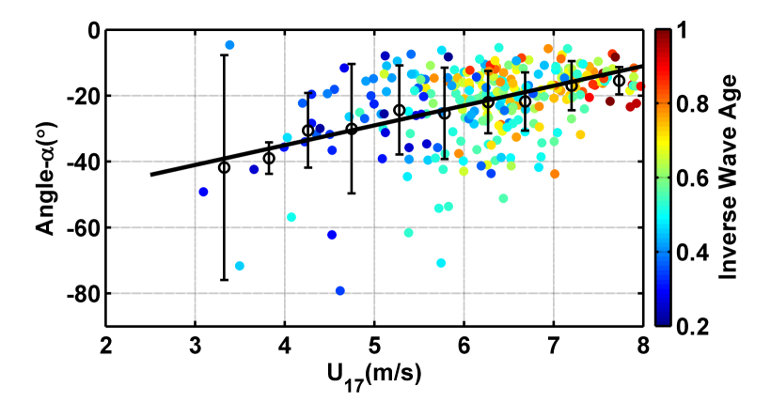
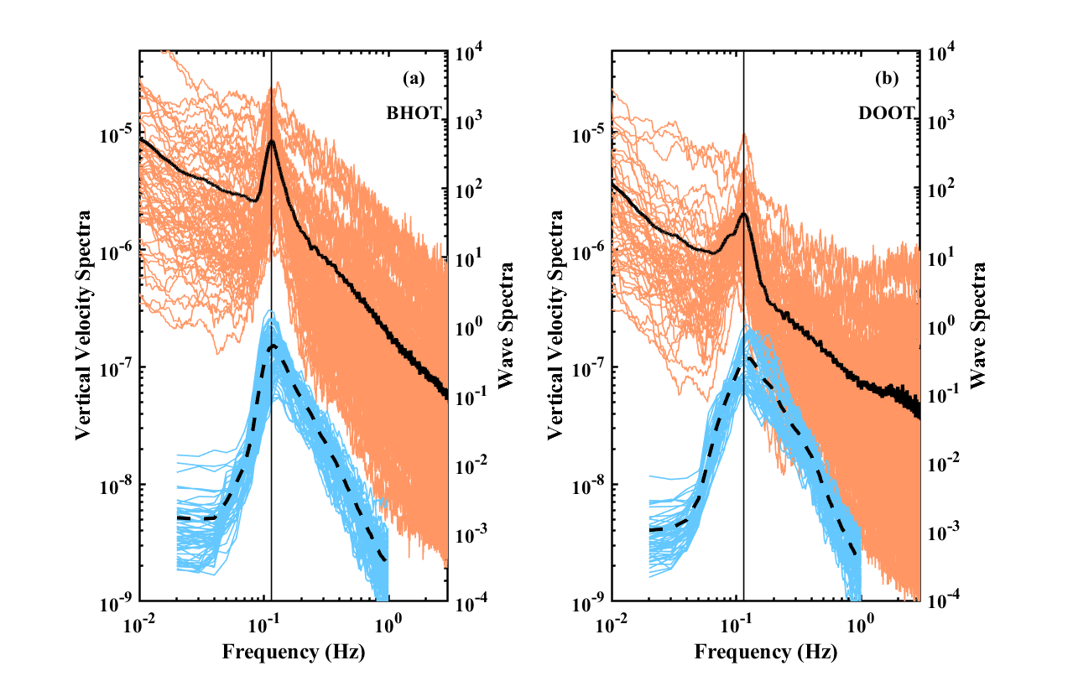
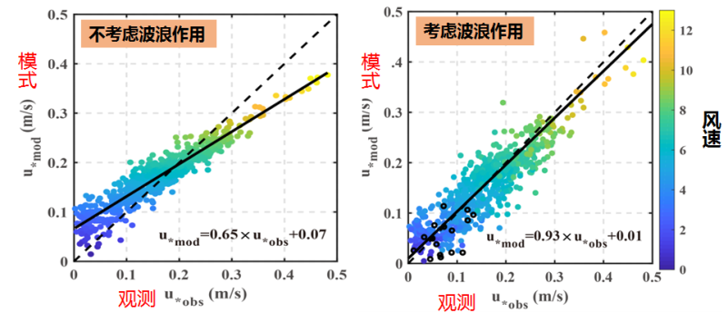
Air-sea heat and momentum fluxes
Bohe at17 m
Dongou at26 m
The effects of surface wave on momentum flux
Chen et al., 2018, JGR; 2019, JPO
Chen et al., 2020, JGR,GRL

Slide 10
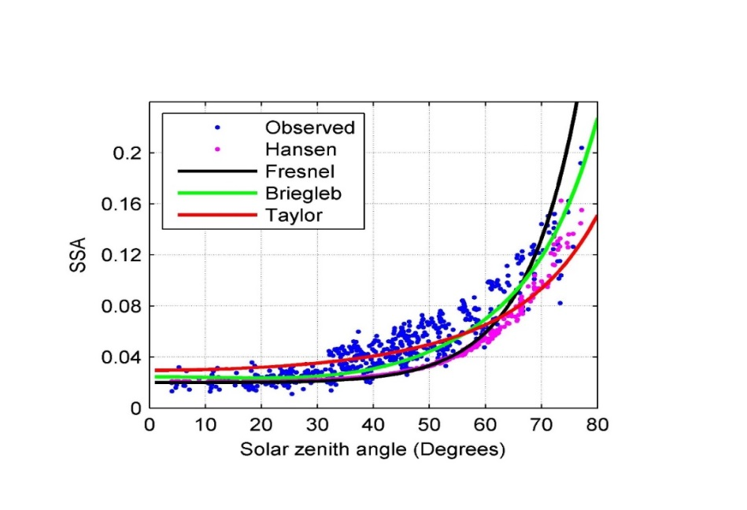
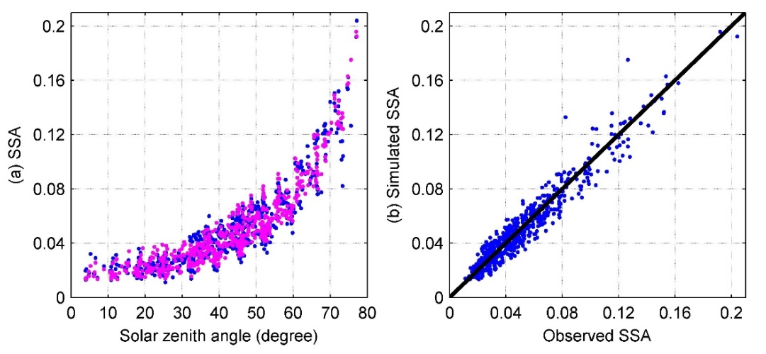
Albedo and surface wave-induced sea-spray
$α_{clear}=\frac{0.041}{μ^{4/3}+0.083}+0.0025w−0.005e_{0}−0.015, β≥0.55$
Huang et al., JGR-Oceans, 2019

Slide 11
1
Requirements and challenges
CONTENTS
2
New era for ocean prediction
3
Applications in climate and TC
4
Summary

Slide 12
How have we made ocean status prediction? The concept behind
As the ocean is so complicated, according to their spatiotemporal scales, oceanographers have been separating ocean into surface wave, tide, ocean circulation into different streams, and made their predictions separately. For accurate long-term prediction, it is time for us to unify the whole ocean as a dynamic system through turbulence.

Slide 13
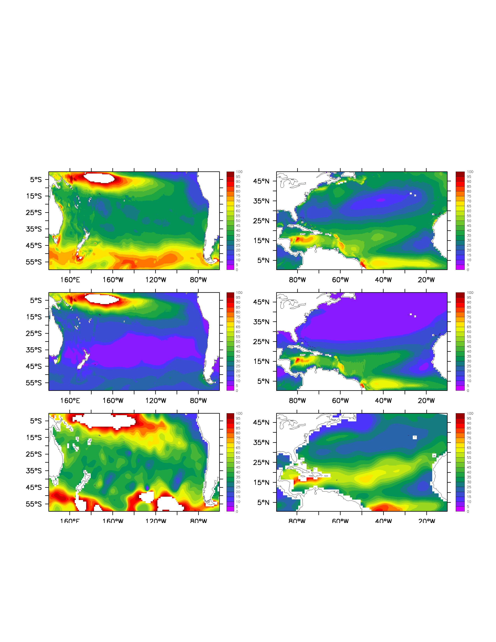
MLD of the Southern Pacific in Feb.
MLD of the Northern Atlantic in Aug.
With wave-induce mixing
Without wave-induce mixing
World Ocean Atlas
(Qiao et al, OD, 2010)
Notes:
We also compared the simulated mixed layer depth.

Slide 14
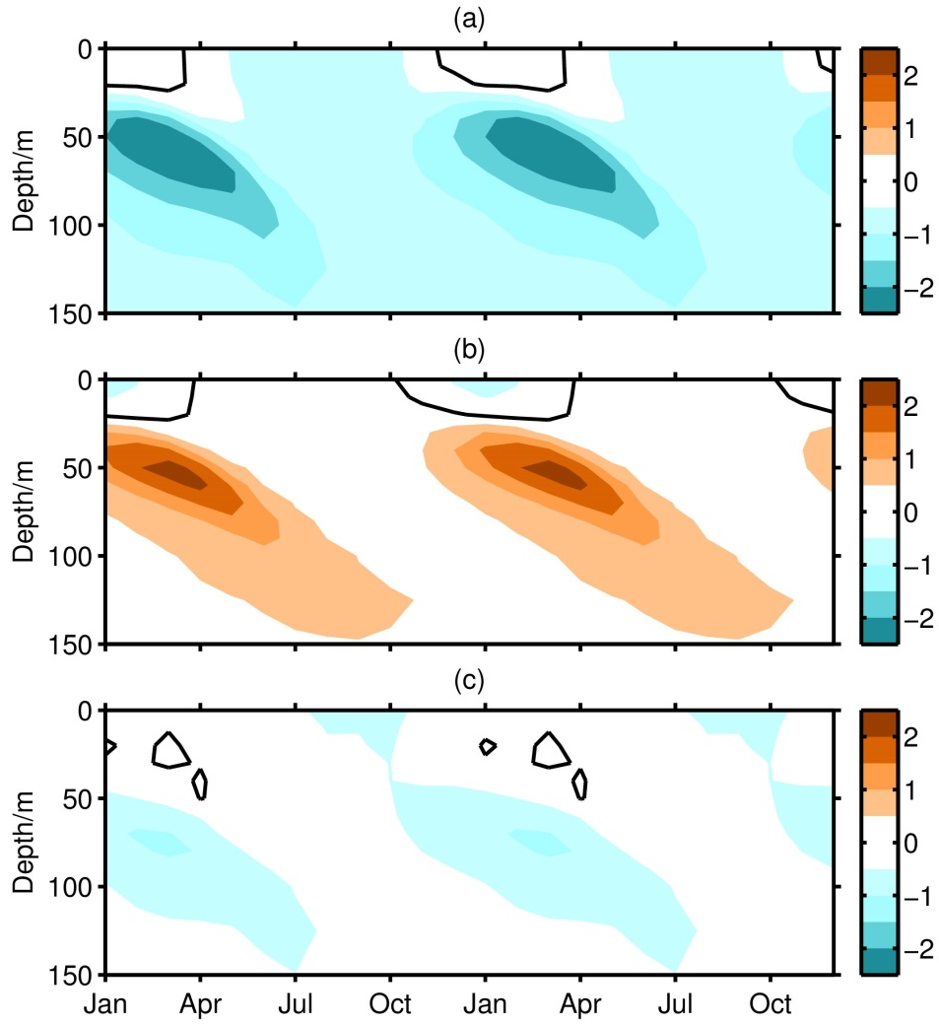
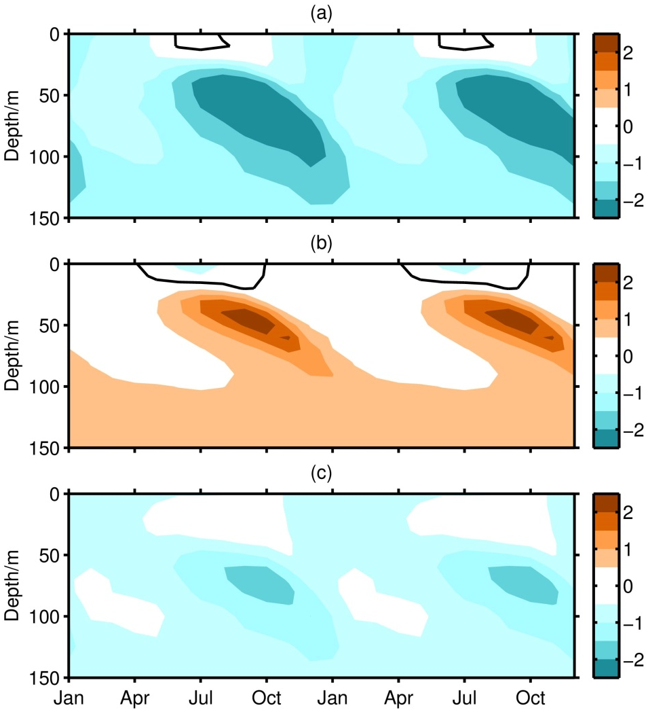
Bv theory has been adopted by NEMO (Europe), GFDL (USA) and AWI of Germany, and has been tested at different popular OGCMs, such as POM, ROMS, MOM etc.
FESOM model improvement of AWI, Germany as an example: error in the upper ocean was killed by about 90%
Wang et al., 2019, JAMES

Slide 15
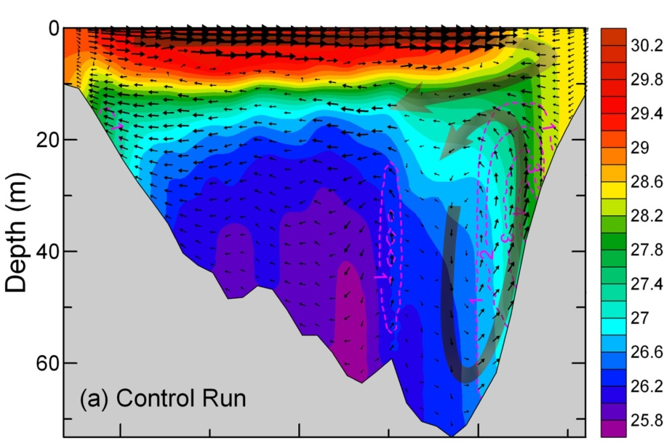
The challenge of Ekman transport theory
Lv Xingang, Qiao Fangli, GRL, 2008
Qiao Fangli, Yang Yongzeng, Lv Xingang et al,, JGR, 2006
Lv Xinggang, Qiao Fangli, Xia Changshui etal, JGR, 2006
Lv Xinggang, Qiao Fangli, Xia Changshui etal, CSR, 2010

Slide 16
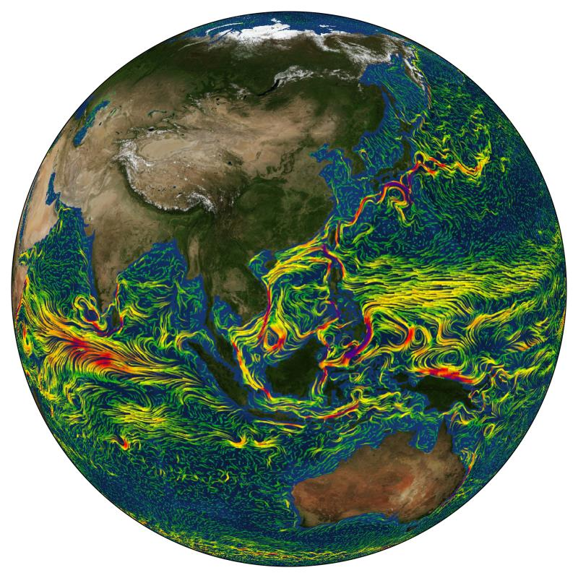
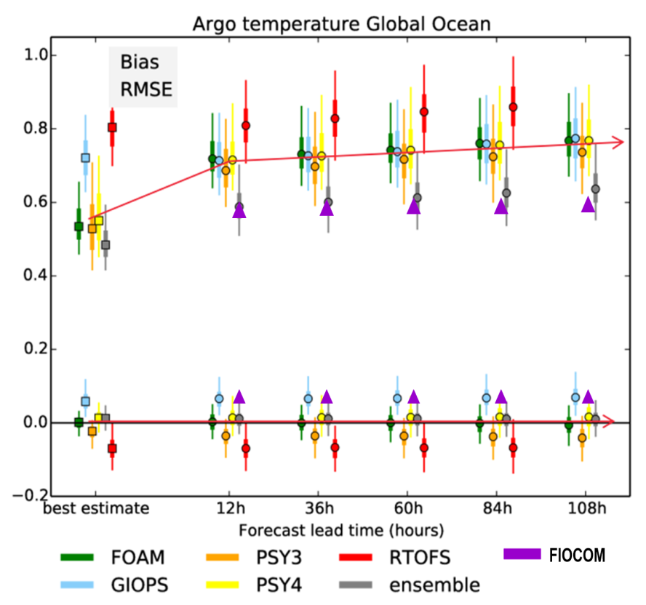
New Ocean Forecasting System (OFS)
To develop the first wave-tide-circulation coupled model, and provide operational service through WETSPAC official website, and APP
FOAM - UK
PSY3/4 - France
RTOFS - USA
GIOPS- Canada
ensemble
FIO-COM (New)

Slide 17
1
Requirements and challenges
CONTENTS
2
New era for ocean prediction
3
Applications in climate and TC
4
Summary

Slide 18
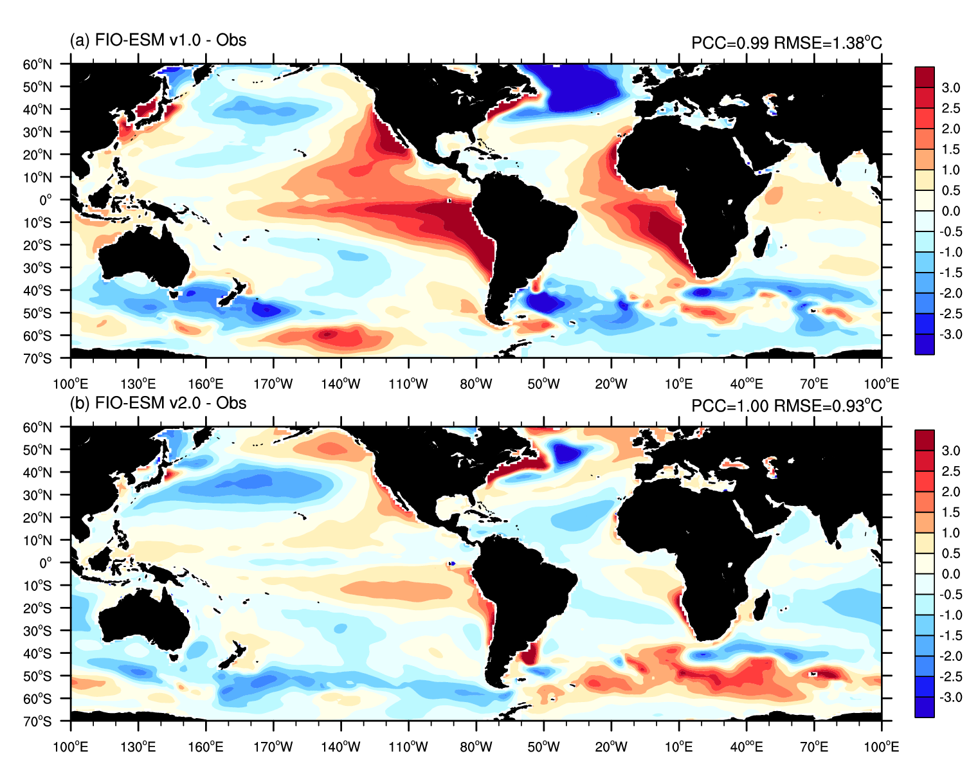
SST Biases
FIO-ESM v2.0
Bv+ sea spray +
Bao et al., 2020, J. Geophys. Res.

Slide 19
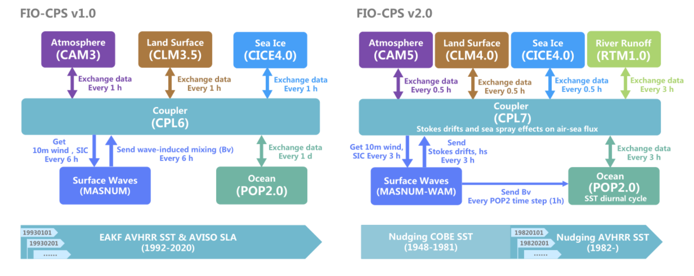
Flowcharts for FIO-CPS v1.0 and FIO-CPS v2.0
Wave-induced mixing
Stocks drift (air-sea flux)
Sea spray (air-sea flux)
SST diurnal cycle
New physical process
Component model is upgraded
Resolution and coupling frequency are improved

Slide 20
Niño 3.4 index predicted skill
ACC
RMSE
The ACC of FIO-CPS v2.0 is 0.78, increases by 11.1% compared with the value of 0.70 in FIO-CPS v1.0

Slide 21
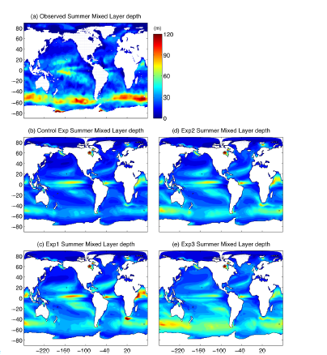
Summertime oceanic mixed layers are biased shallow in both the GFDL and NCAR climate models (Bates et al. 2012; Dunne et al. 2012, 2013).
This scheme (Qiao et al., 2004) has most impact in our simulations on deepening the summertime mixed layers, yet it has minimal impact on wintertime mixed layers.
Yalin Fan, and Stephen M. Griffies, 2014, JC

Slide 22
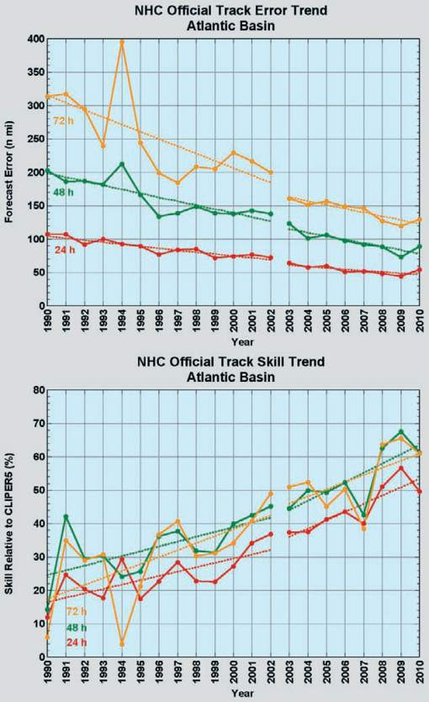
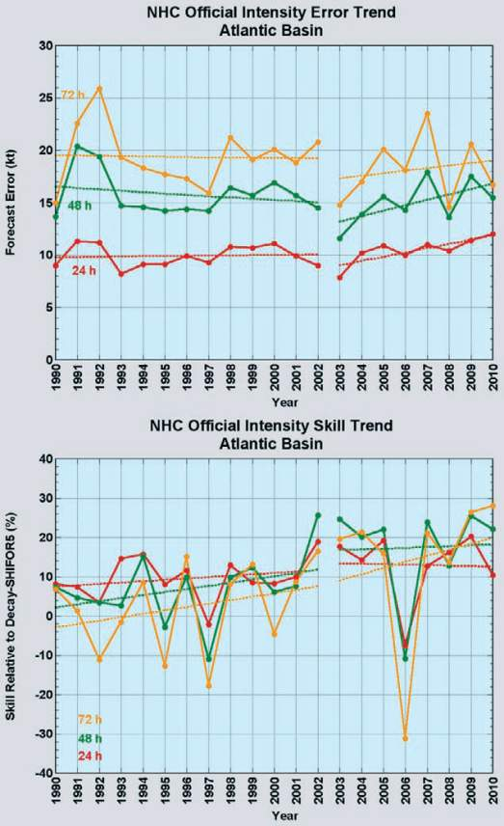
Ground challenge III: The forecasted TC track getting better and better, while the forecasted intensity has had no any progress for the past several decades.
Rappaport et al., 2012, BAMS

Slide 23
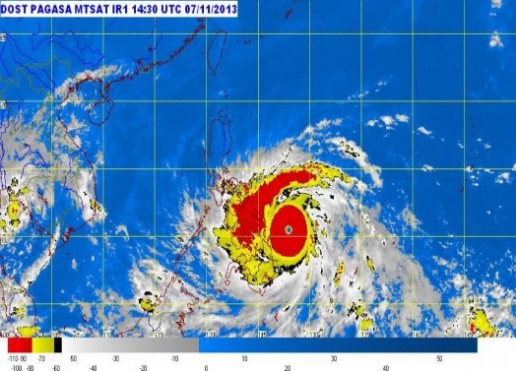
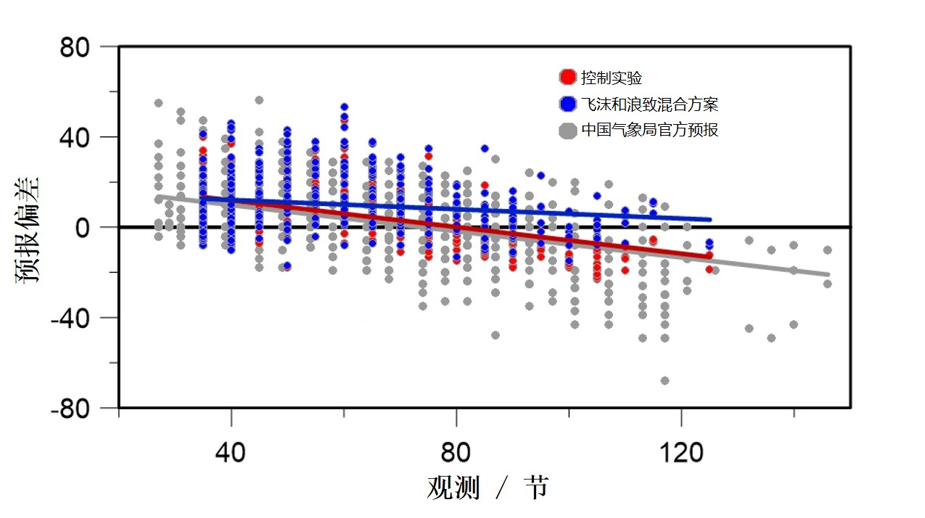
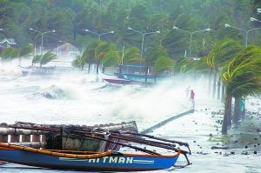
Dramatic improvements on forecasting of strong Typhoon intensity
Control test
Sea-spray + Bv
CMA
Forecasting Error
Observed Typhoon intensity (knot)
Strong Typhoons no less than category IV (41.5m/s): Kill error 32%
Super Typhoons no less than category V (51.0m/s): Kill error 58%
Notes:
Andreas根据观测数据将飞沫感热和潜热通量表达为如下两个公式，这样就就可以将计算得到的结果直接叠加到海气界面热通量上

Slide 24
1
Requirements and challenges
CONTENTS
2
New era for ocean prediction
3
Applications in climate and TC
4
Summary

Slide 25

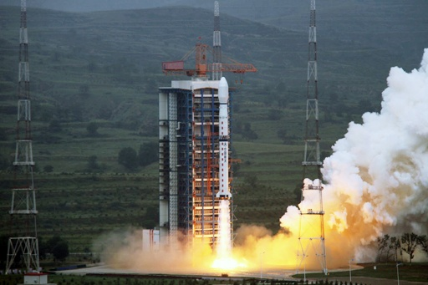
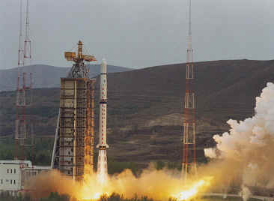
The needed observation for predicton
High cost: the cost for ocean observation is still very high. Could reduce the cost to 10%? Yes, we can;
Parameter-limited: the observation mainly focused on physical parameters, and biogeochemical observations are crying needed;
Space-cover limited: we are lack of observation ability in deep ocean, in polar areas and in the southern ocean;
Data share problem: Could we share our facilities, technology and data?

Slide 26
Conclusions
For long-term prediction, it is time for us to regard ocean as a unified dynamic system. Small scale surface waves play dominant role in ocean turbulence and air-sea interaction.
With above scientific understanding, it is quite promising that we can have much longer prediction ability on ocean, tropical cyclones and climate under UN Ocean Decade;
More data are never enough for better prediction. The transfer from scientific findings to operational centers and then public service is spirit of “A Predicted Ocean”;
We have proposed WG40 and POC to host a platform for providing operational climate prediction and services for PICES.

Slide 27

A Predicted Ocean of UN Ocean Decade
Let’s PREDICT: Long-term accurate ocean prediction is coming

