Slide 1



Co-occurrence of California drought and northeast Pacific marine heatwaves under climate change
“Coupled climate stressors along the U.S. west coast: drought, marine heatwaves, HABs and hypoxia” Project
Daisy Hui Shi, Marisol García-Reyes, and William Sydeman
Farallon Institute; Petaluma, CA
Ryan Rykaczewski
NOAA Pacific Islands Fisheries Science Center; Honolulu, HI
Bryan Black
University of Arizona; Tucson, AZ
Steven Bograd and Michael Jacox
NOAA Southwest Fisheries Science Center; Monterey, CA

Slide 2
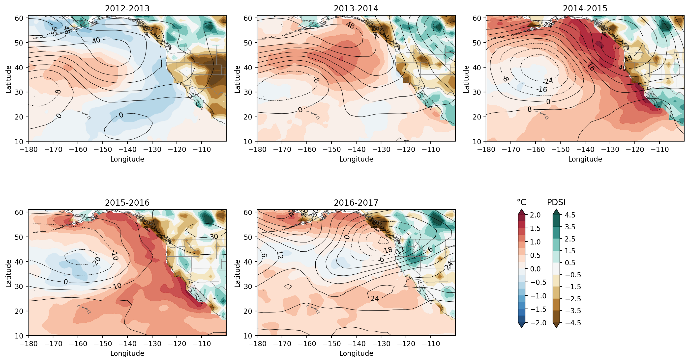
Evolution of the 2013-2016 event
Notes:
MHW, blob, drought
SSTa over ocean, drought condition over land, hydrological years centered around winter season starting 2012 to 2017
Significant impacts on ecosystem and economy, people’s lives

Slide 3
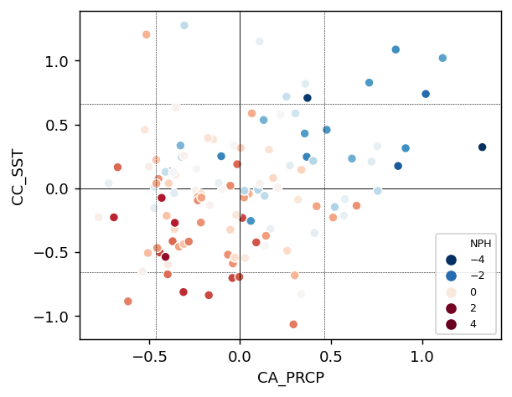
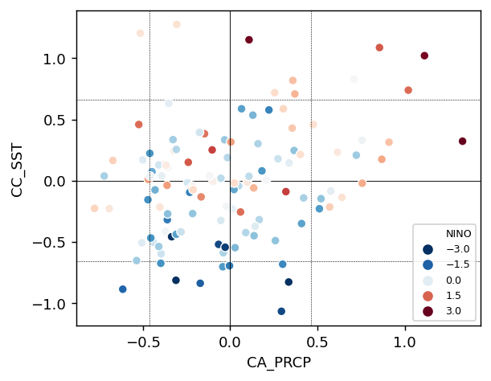
Co-occurrence of MHW and drought is atypical for CA
North Pacific High (NPH)
El Nino-Southern Oscillation (ENSO)
Warm & dry
Warm & wet
Warm & dry
Warm & wet
CA Current SST anom.
CA Current SST anom.
Cold & dry
Cold & dry
CA prcp. anom.
CA prcp. anom.
Strong NPH
El Nino
Enhanced
upwelling
Oceanic wave/warm advection
atmos. teleconnections
Cold SST
Less rainfall
Warm SST
More rainfall
Notes:
Both MHW and drought are no strangers to CA, but they occurred together not typical
Consider two large scale climate systems affect CA climate
Scatter plots, Color coded with NPH index, Nino index
45 degree line, warm dry unusual

Slide 4
Evolution of the 2013-2016 event
Ridiculously Resilient Ridge
Notes:
500 gph overlay
There was a very persistent ridge of higher-than-normal atmospheric pressure over the northeast Pacific Ocean,
reduced surface winds, advection of cold water, reduced heat loss from ocean to atmosphere
it continued deviate Pacific storm track during CA rainy season

Slide 5
Question 1
How frequent did CA drought and NEP MHW co-occur in the past?
Notes:
What has caused this co-occurrence, our question is has this type of event occurred before?

Slide 6
Data
Observations in the 20th century
  Sea surface temperature
  Palmer Drought Severity Index (PDSI)

Slide 7
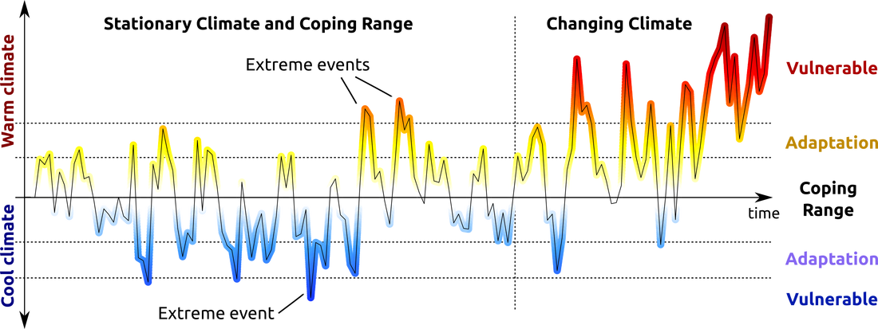
Define extremes in a changing climate
Current baseline
fixed climatology/threshold, long-term trend retained
Shifting baseline
contemporaneous climatology/threshold, trend removed
Notes:
One way commonly used to define extremes is …
Changes are dominated by trends
Another way
More information on the dynamics of the climate system
We focus on the second approach

Slide 8
CA drought co-occur with MHW in two locations:
PDSI
500 hPa anom. (m)
SSTa
1. CA drought co-occurring with Gulf of Alaska marine heatwave.
2. CA drought co-occurring with CA Current marine heatwave.
Notes:
Point out CA state, CC

Slide 9
Such co-occurrences are rare across the instrumental history 1900-2019
2013-2014
2014-2015
Rare occurrence and unique sequence
Notes:
Time series of SST PDSI, after removing trends,
Based on shifting baseline to define of drought and MHW, bars
we identified 2 years of co-occurrence during the 2013-2016 event
Only one other instance each
another thing we noticed the unique sequence, consecutive co-occurrences, all three extremes co-occur together, which is unprecedented

Slide 10
Question 2
How will their co-occurrence change in the future under climate change?
Notes:
Now we know these co-occurrences are rare in the past. How about the future? What are the frequency of these types of events? are they related to global warming?

Slide 11
Data
Coupled Model Intercomparison Project Phase 6 (CMIP6)
  Preindustrial control run (piControl, 30 years), as a reference
  Future projection at the end of 21st century (2070-1099), SSP5-8.5
Notes:
Model simulations from, select 22 models, look at ensemble
modeled SST from CC and soil moisture for CA, warming and drying trends
we used..
cases with no warming, GHG concentration fixed at preindustrial level
and compared ...
fossil-fuel intensive development, worst case scenario

Slide 12
Compound extremes that occur about once per century
Based on thresholds (90th and 10th percentiles), if independent:
P_{co-occur} = 0.1 x 0.1 = 0.01
Notes:
Extremes are small-chance events, compound extremes, frequency of occurrences are even smaller
Reference frequency to interpret the results

Slide 13
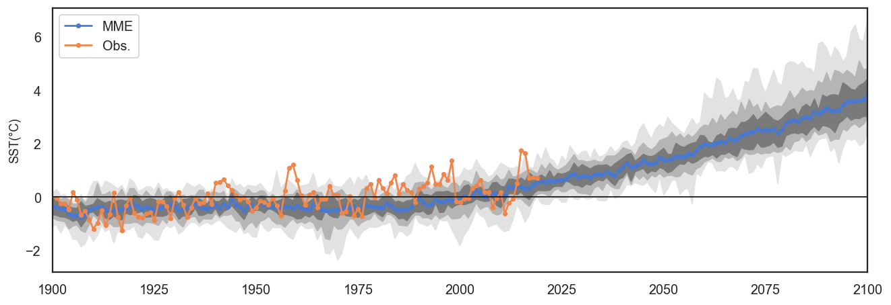
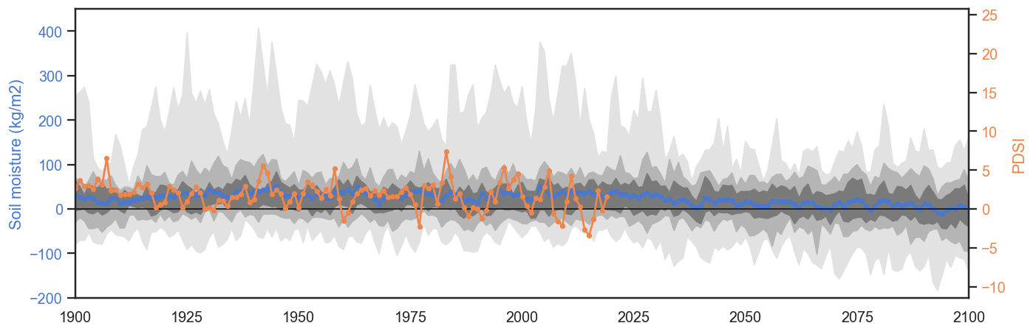
Future co-occurrences with current baseline
Numbers of co-occurrences per century in the preindustrial control (piControl) and future (SSP5-8.5) simulations
 | piControl (30-yr period) | Future (SSP5-8.5 2070-2099) | Change ±1SD (future minus piControl) | Fraction of Attributable Risk (FAR)
Long-term trends retained/fixed climatology
Hot GOA + dry CA | 1.15 | 43.6 | 42.5 ±2.39 | 0.97 [0.97,0.98]
Hot CC + dry CA | 0.80 | 43.6 | 42.8 ±1.91 | 0.98 [0.98,0.99]
SST
90th percentile
Extremely hot SST in both the GOA and CC increases from 10% in the piControl simulation to 100% by end of century.
Changes in extremely dry conditions in CA are less dramatic, increasing from 10% in the piControl to 44% by end of the century.
There is roughly a 40-fold increase in co-occurrence
PDSI/Soil moisture
10th percentile
fixed climatology/threshold, long-term trend retained
Notes:
40 fold increase
PDF, rightward shift, almost all SSTa are above the 90th thresholdhold, and are considered extremes
change in frequency in individual extremes
the way we define extremes, largely reflecting warming and drying trends
>0, almost 1, largely caused by AF

Slide 14
Future co-occurrences with shifting baseline
Numbers of co-occurrences per century in the preindustrial control (piControl) and future (SSP5-8.5) simulations
 | piControl (30-yr period) | Future (SSP5-8.5 2070-2099) | Change ±1SD (future minus piControl) | Fraction of Attributable Risk (FAR)
Long-term trends removed/contemporaneous climatology
GOA MHW + CA drought | 1.11 | 1.67 | 0.56 ±0.30 | 0.34 [0.24,0.43]
CC MHW + CA drought | 0.73 | 0.61 | -0.12 ±0.27 | -0.20 [-0.45,0.05]
The co-occurrence of GOA MHW and CA drought increases ~50%.
MHWs
contemporaneous climatology/threshold, trend removed
Notes:
Co-occurrence in piControl is about 1 event per century, future increases to >1.5 event per century, less dramatic, due to the way to define
Robust, and 50% increase, partially due to AF
Full distribution of GOA SSTa during CA drought, rightward shift of SSTa in the future, increase in warm extremes
warmer SST during CA drought after removing trends

Slide 15
Future co-occurrences with shifting baseline
Numbers of co-occurrences per century in the preindustrial control (piControl) and future (SSP5-8.5) simulations
 | piControl (30-yr period) | Future (SSP5-8.5 2070-2099) | Change ±1SD (future minus piControl) | Fraction of Attributable Risk (FAR)
Long-term trends removed/contemporaneous climatology
GOA MHW + CA drought | 1.11 | 1.67 | 0.56 ±0.30 | 0.34 [0.24,0.43]
CC MHW + CA drought | 0.73 | 0.61 | -0.12 ±0.27 | -0.20 [-0.45,0.05]
The co-occurrence of CC MHW and CA drought does not change.
Notes:
piControl, less than one event, tend not to co-occur, future still less than one
change in the future is not robust
Distribution of CC SSTa during CA drought, leftward shift, cooler SSTs during CA drought in the future, little change in the extremes

Slide 16
Different coupling mechanisms for GOA and CC
PDSI
500 hPa anom. (m)
SSTa
GOA MHW-CC MHW connection
Atmospheric ridge
Persistence of CA drought
ENSO/NPH variability
Increase freq.
Decrease freq.
Notes:
based on these analyses, one thing really interesting to us is that different change in co-occurrences
GOA, coupled by atmospheric ridge, increase co-occurrence, increase in ridge
CC, not directly coupled
Mediated by the lead-lag relation between GOA and CC MHWs, affected by the persistence of drought
(if blob in GOA didn’t occur, if drought only lasted for one year, the co-occurrence might not be able to happen)
these two change in the opposite directions
Also as their co-occurrence remain the same as in the piControl, it is likely still largely dictated by.. as we discussed at the beginning

Slide 17
Summary
With current baseline, anthropogenic warming will dramatically increase the co-occurrence of extreme hot Northeast Pacific and dry California conditions, through long-term warming and drying trends
With shifting baseline, California drought co-occurs more frequently with marine heatwaves in Gulf of Alaska (GOA) but not in California Current (CC), suggesting different coupling mechanisms in these two locations from a statistical perspective
Notes:
We examined the future changes in co-occurrence of CA drought and NEP MHWs
Uncertainties: limitations on sampling years, considerable model spread

