Slide 1
Response of abundance and distribution of Humboldt squid (Dosidicus gigas) to short-lived eddies in the Eastern Equatorial Pacific Ocean
2018 PICES annual meeting
2021.08.31
Wei Yu, Xingnan Fang, Xinjun Chen
College of Marine Sciences, Shanghai Ocean University
Email: wyu@shou.edu.cn

Slide 2
Outline
Background
Results
Summary

Slide 3
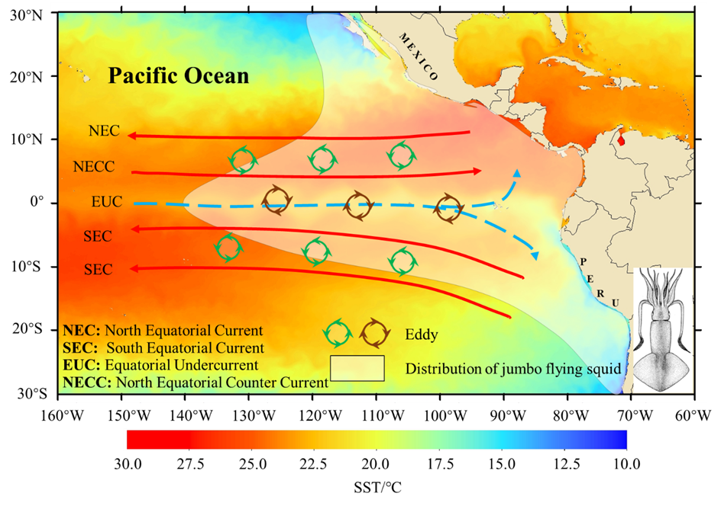
Research background
Mesoscale eddy
Marine material transportation and heat transfer
Redistribution in nutrients and plankton
Large amounts of fishes around the eddies
Dosidicus gigas
Economically important species
Wide distribution in the Eastern Pacific Ocean
Subject to complicated environmental changes (ENSO, SST, NPP, SSH, etc. )
Figure Geographical distribution of Dosidicus gigas with oceanic environmental conditions [major tropical Pacific currents, the eddy and sea surface temperature (SST)] in the Eastern Pacific Ocean.

Slide 4
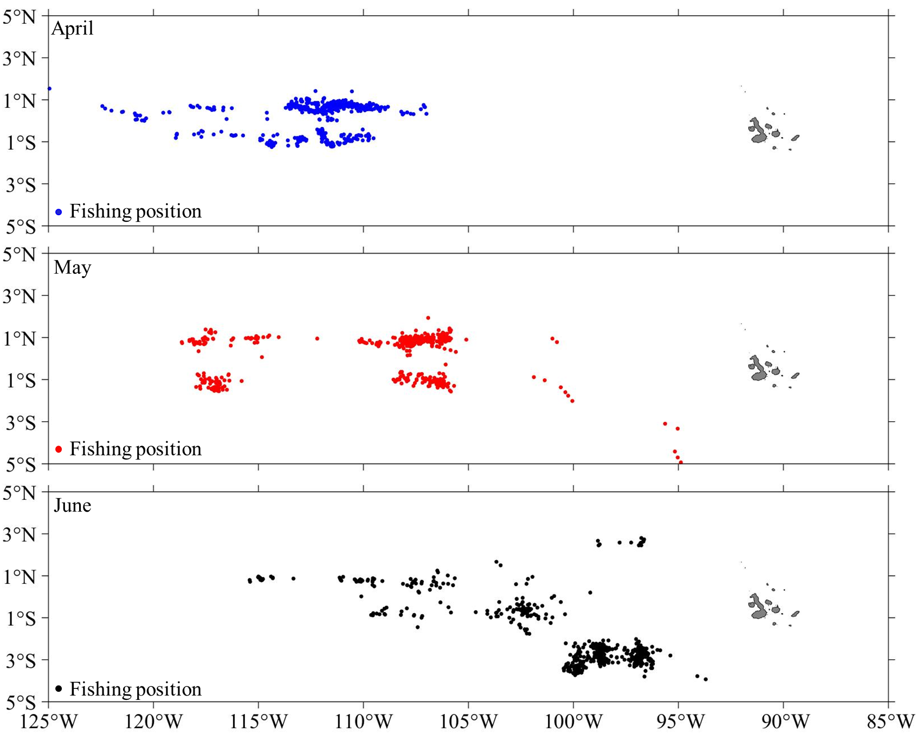
Research background
Fishing ground at equator
Time range: April-June, 2017;
Fishing ground: 5ºN-5ºS and 125º-85ºW;
Objectives
Clarify the characteristics of eddies in the equatorial waters;
Evaluate eddy impacts on the biophysical environment of the equatorial waters;
Examine the relationship between eddy activity and the abundance and habitat distribution D. gigas;
Objectives
Figure Monthly distributions of fishing positions for the Chinese squid-jigging vessels from April to June 2017 on the fishing ground of Dosidicus gigas in the equator.

Slide 5
Materials
Fisheries data
Fishing date (year and month);
Fishing position (latitude and longitude);
Catch (unit: tons);
Fishing effort (fishing days);
CPUE (t/d);
Geostrophic field data
U: East component
V: North component
SLA: Sea level anomaly
(time resolution: one day
spatial resolution:0.25º$×$ 0.25º )
Environmental data
The water temperature data at seven different layers (0m, 30m, 50m, 75m, 100m, 120m, 150m )
(time resolution: three days
spatial resolution: 0.1º$×$0.1º )
Chl-a concentration
(time resolution: one days
spatial resolution: 4km)
National Distant-water Fisheries Data Center of China (NDFDC)
NetCDF Subset Service (NCSS) under Unidata
Asia Pacific Data Research Center (APDRC)

Slide 6
Methods
Geostrophic field data
Vector geometry method
Characteristic of eddy
Eddy
Identification
U: East component
V: North component
1. the center of eddy
2. the boundary of eddy
3. the lifetime of eddy
1.Type 2.Position
3. Boundary 4.Lifetime
et al
Biophysical
Environment
Case: lifetime>2 weeks
(6 days as a period)
The changes of SST, vertical temperature and Chl-a in different periods
The influences of eddies on the biophysical environment
Evaluate the performance of the AMM-based HSI model and assess the habitat suitability of D. gigas in eddy
Environmental data
(SST,Temp_50, Temp_100 and Chl-a)
Develop SI model for
each environmental variable
Habitat
Suitability
3 days
0.1º$×\text{0.1}\text{o}$
Fishery data (Fishing effort)
Calculate fishing effort, CPUE, catch, HSI in different periods
poor habitat: HSI≤0.2
common habitat: 0.2<HSI<0.6
suitable habitat: HSI≥0.6

Slide 7
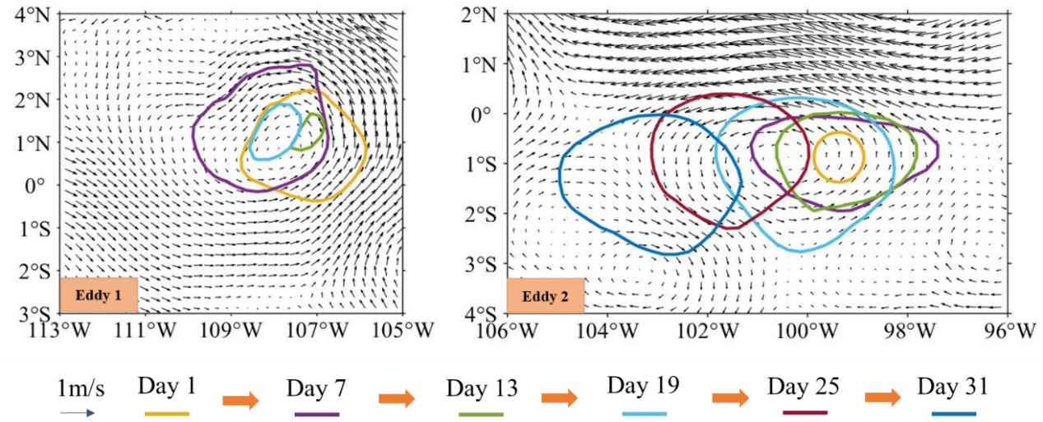
Results
1. Identification and characteristic analysis of the eddies
Table The lifetime and number of eddies from April to June 2017.
Figure The division of eddy lifetime for two eddies used as case studies.
Month | Life time /d
 | 1~7 | 8~14 | t>14
April | 64 | 3 | 1
May | 63 | 6 | 2
June | 54 | 2 | 0
Figure Tracks of eddies used as case studies.

Slide 8
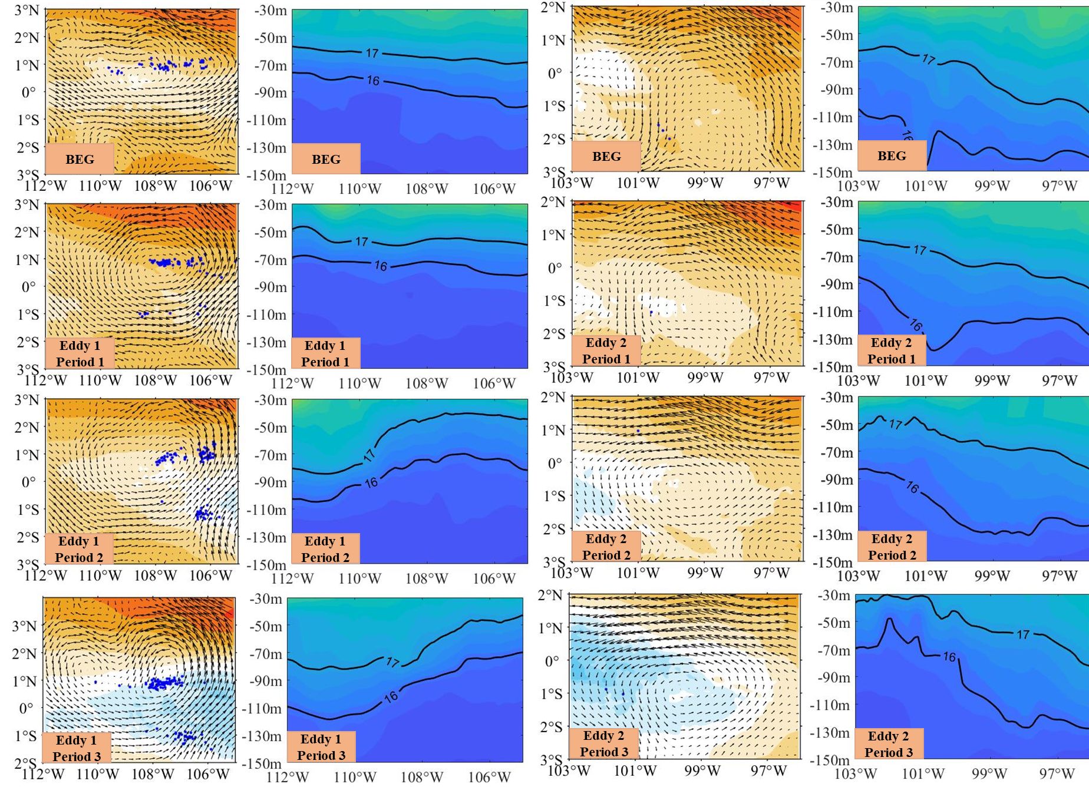
Results
2. The influences of eddies on the biophysical environment
Figure Spatial distribution of sea surface temperature (SST) and vertical temperature structure (VT) with the effects of eddies 1 and 2.

Slide 9
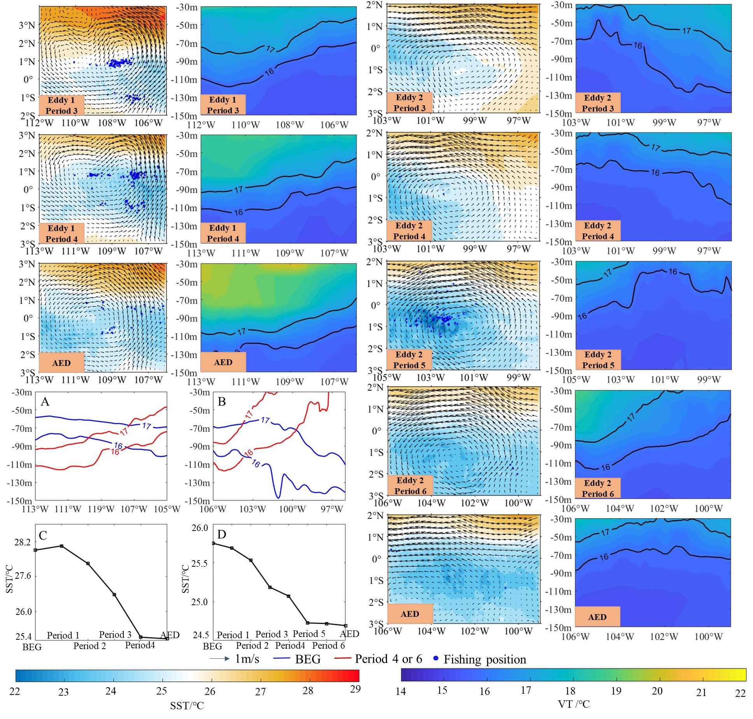
Results
2. The influences of eddies on the biophysical environment
A (eddy 1) and B (eddy 2) shows the isothermal line of the vertical temperature structure (16ºC and 17ºC) during the period of the BEG (before the eddy generation, blue line) and period 4 of eddy 1 and period 6 of eddy 2 (red line). C (eddy 1) and D (eddy 2) shows the variations of average sea surface temperature (SST) in different periods

Slide 10
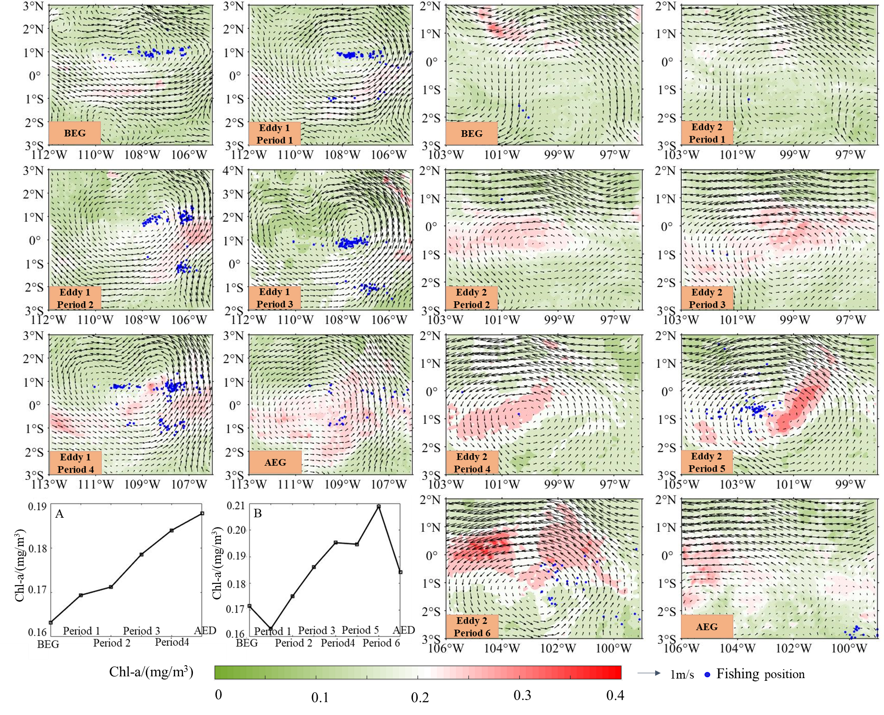
Results
2. The influences of eddies on the biophysical environment
Figure The effects of eddies 1 and eddy 2 on chlorophyll-a (Chl-a) concentration on the fishing ground of Dosidicus gigas in the Eastern Equatorial Pacific Ocean.
A (eddy 1) and B (eddy 2) shows the variations of chlorophyll-a (Chl-a) concentration in different periods.

Slide 11
Results
3. The influences of eddy on the D. gigas abundance and spatial distribution
A
B
Figure A shows monthly variations of the number of the eddy and mean catch per unit effort (CPUE) from April to June 2017 on the fishing ground of Dosidicus gigas in the equator. B shows the variations of center of eddy and longitudeinal gravity center of fishing efforts (LONG) of Dosidicus gigas.

Slide 12
Results
3. The influences of eddy on the D. gigas abundance and spatial distribution
C
D
Figure C shows the variations of the total catch and fishing efforts in different periods of eddy 1. D shows the proportion of catch and fishing efforts of Dosidicus gigas in the whole study area and the variations of catch per unit effort (CPUE) in the different periods of eddy 1.

Slide 13
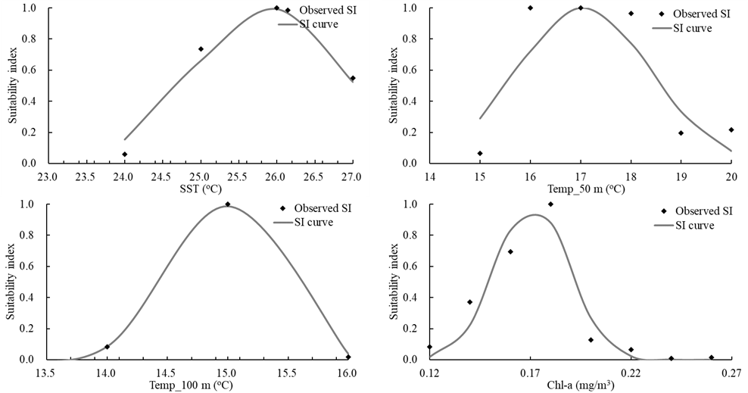
Results
4. HSI model development and validation
Figure Fitted suitability index (SI) curves based on the relationship between fishing effort and each environmental variable including SST, 50m_T, 100m_T, and Chl-a.
$$SI_{SST}=\exp\left[a×(X_{SST}−b)^{2}\right]$$
$$SI_{Temp_50m}=\exp\left[a×(X_{Temp_50m}−b)^{2}\right]$$
$$SI_{Temp_100m}=\exp\left[a×(X_{Temp_100m}−b)^{2}\right]$$
$$SI_{Chl−a}=\exp\left[a×(X_{Chl−a}−b)^{2}\right]$$
Table 2 Proportion of catch and fishing effort in HSI value ranges predicted by habitat models
Table 1 Suitability index model for Dosidicus gigas. RMSE indicated the Root Mean Squared Error.
Suitability index model | R² | P | RMSE
$${SI}_{Chl−a}=\exp\left(−1559{\left(X_{Chl−a}−0.171\right)}^{2}\right)$$ | 0.915 | <0.05 | 0.015
$${SI}_{SST}=\exp\left(−0.522{\left(X_{SST}−25.889\right)}^{2}\right)$$ | 0.968 | <0.05 | 0.080
$${SI}_{50m_T}=\exp\left(−0.292{\left(X_{50m_T}−7.097\right)}^{2}\right)$$ | 0.806 | <0.05 | 0.203
$${SI}_{100M_T}=\exp\left(−5.605{\left(X_{100m_T}−28.365\right)}^{2}\right)$$ | 0.998 | <0.05 | 0.001
HSI | Effort | Catch
0~0.2 | 0 | 0
0.2~0.6 | 35% | 36%
0.6~1 | 65% | 64%

Slide 14
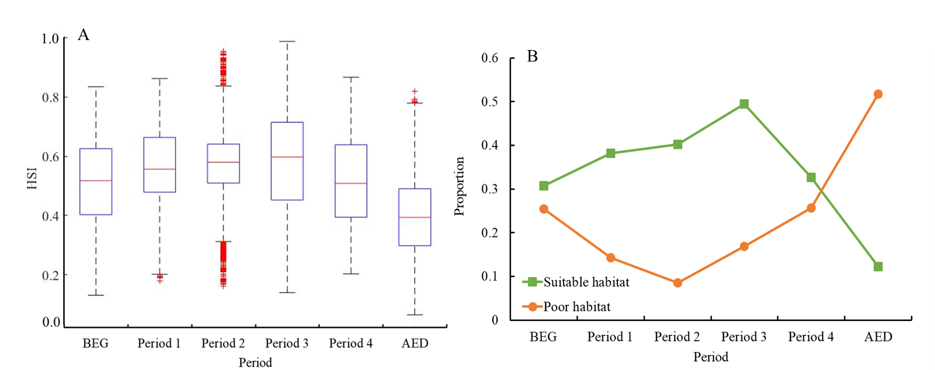
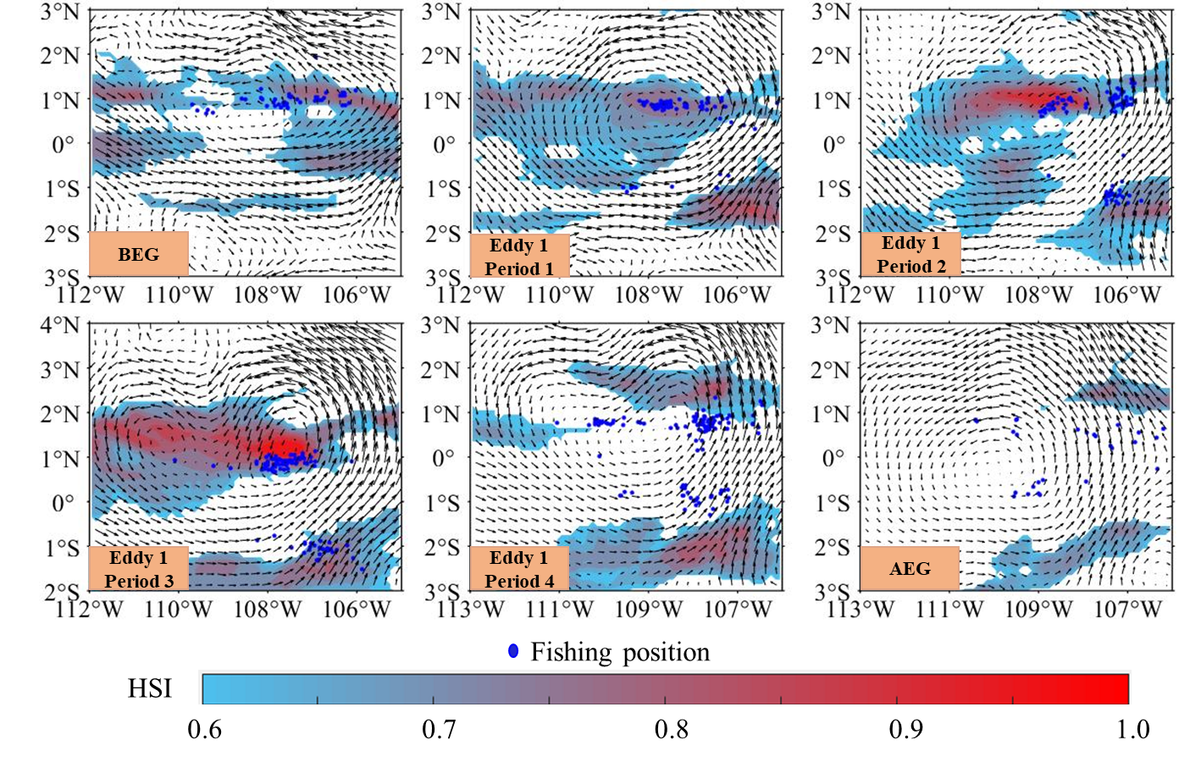
Results
5. The distribution of suitable habitats of D. gigas within eddy 1
Figure The effects of eddies 1 and eddy 2 on chlorophyll-a (Chl-a) concentration on the fishing ground of Dosidicus gigas in the Eastern Equatorial Pacific Ocean.
Figure A (eddy 1) and B (eddy 2) shows the variations of chlorophyll-a (Chl-a) concentration in different periods.

Slide 15
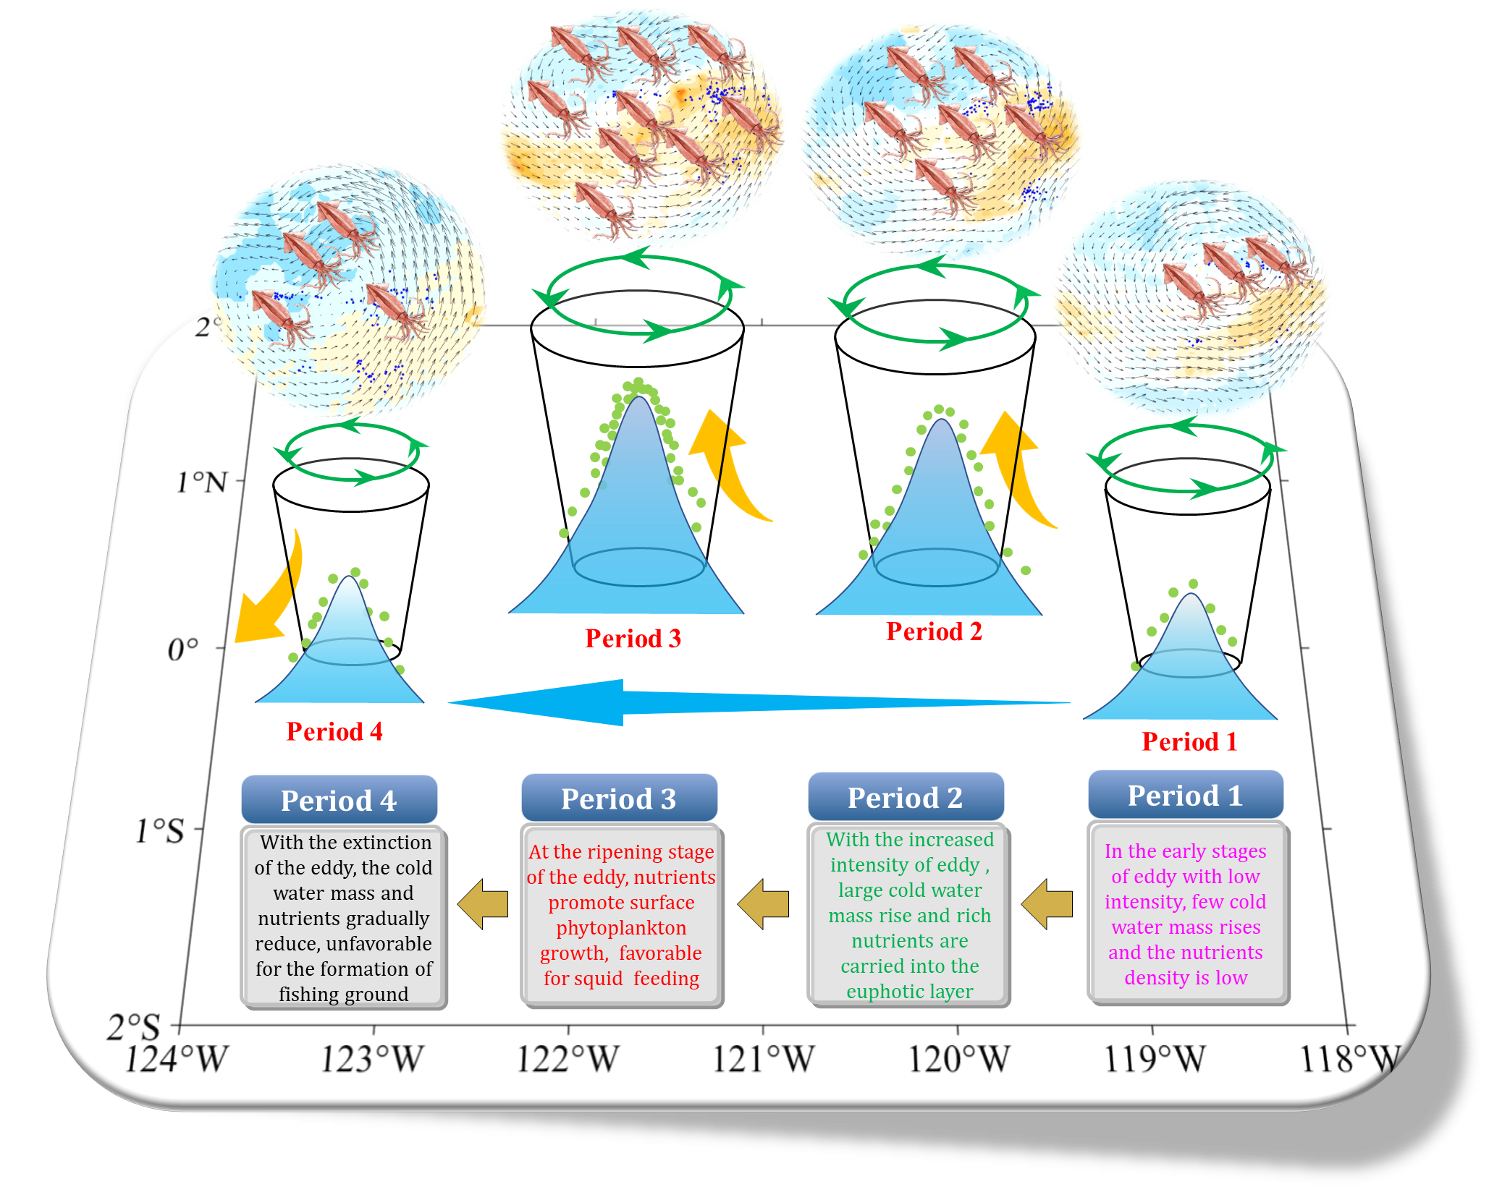
Results
5. The distribution of suitable habitats of D. gigas within eddy 1
Extinction
Maturation
Intensification
Formation
Figure The influence mechanism of the equatorial eddy on physical and biological environments and distribution and abundance of Dosidicus gigas in the Eastern Equatorial Pacific Ocean

Slide 16
Summary
The eddy lifetime in equatorial water was relatively short, with only three eddies persisting for more than two weeks from April to June, 2017.
Two eddies were taken with a lifetime above two weeks, which revealed that the environmental conditions around the eddies significantly changed. When the eddy persisted for 8-10 days, SST and vertical temperature gradually decreased, but Chl-a significantly increased.
The HSI model based on SST, Temp_50m, Temp_100 m and Chl-a, was better to examine the habitat changes of D. gigas around the eddy.
These environmental changes are help for the formation of high-quality habitats, which increases D. gigas abundance and catch, and droves the shift of the gravity centers of fishing ground with the eddy.
The eddy-induced Ekman pumping led to the transportation of deep waters with rich nutrients into the euphotic layer, promoted the reproduction of bait organisms and yielded favorable water temperature conditions for D. gigas.

Slide 17
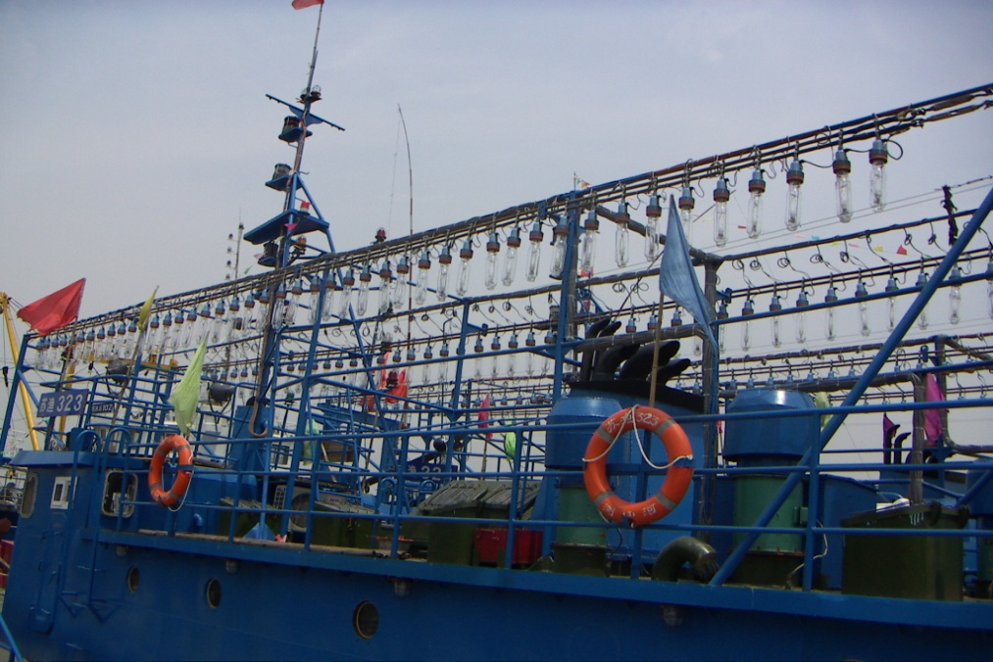
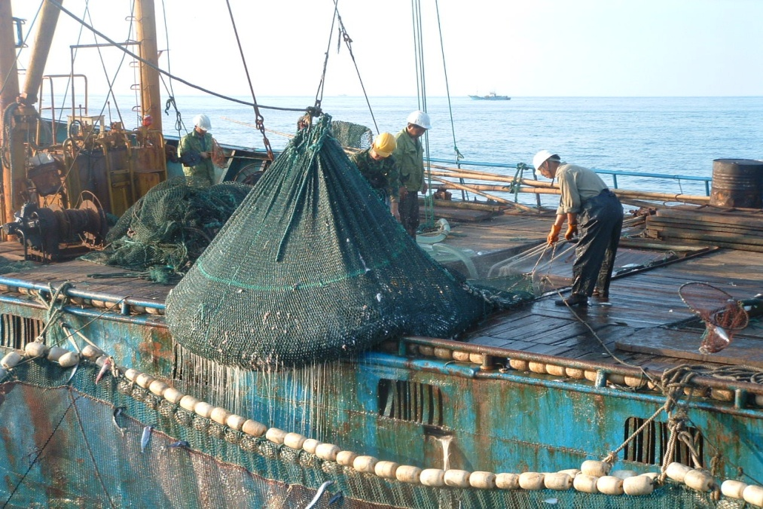
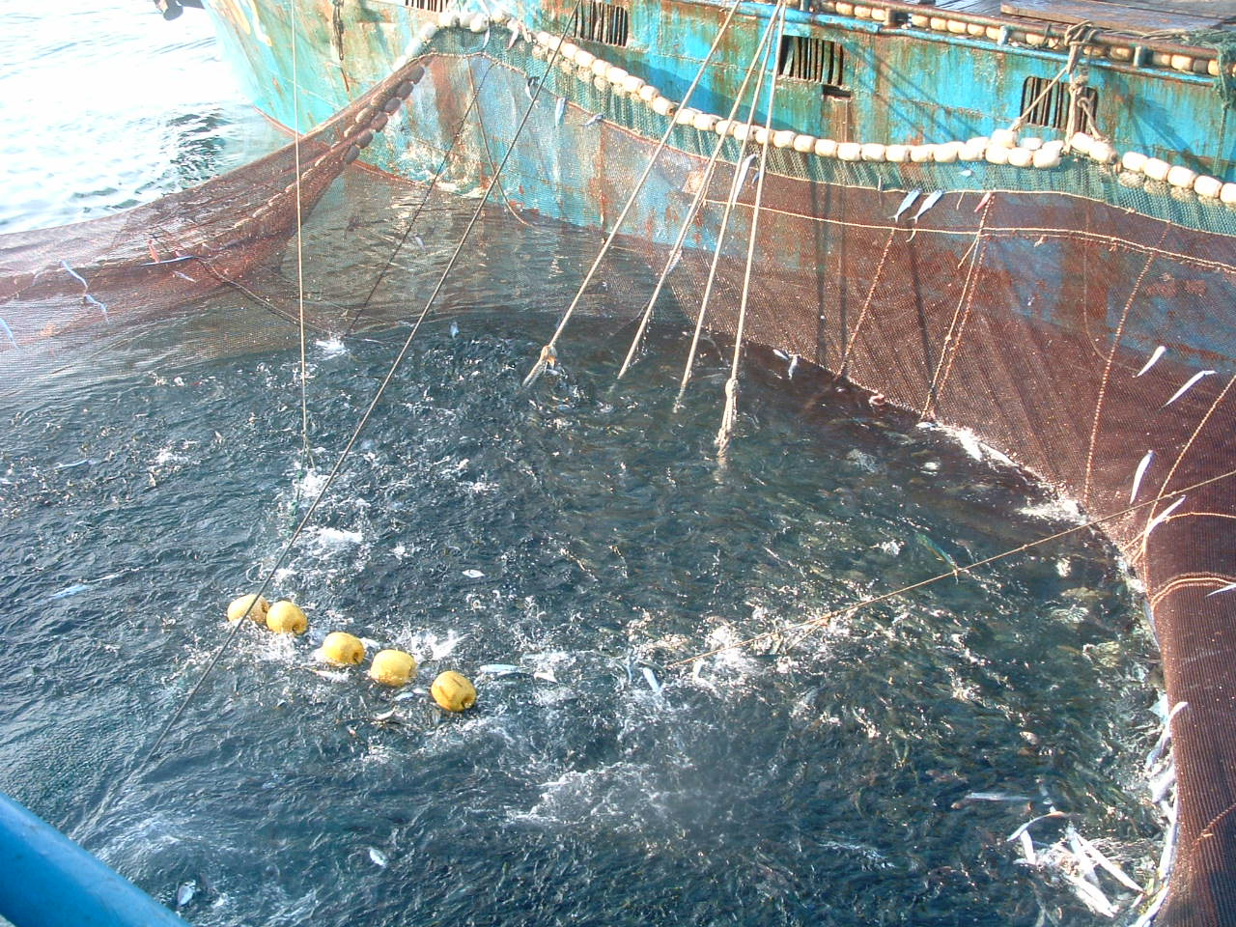
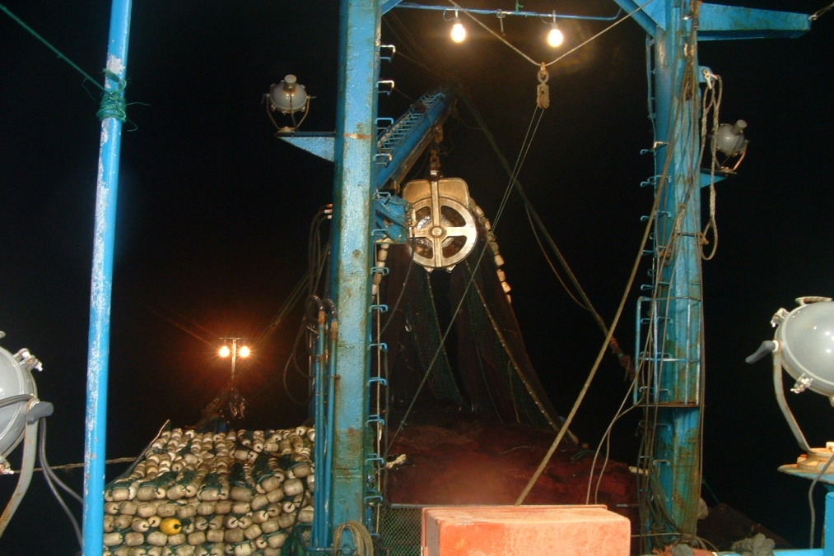
谢 谢！
Thanks for your attention

